Slide 1
DIVISION OF CRIMINAL INVESTIGATION
January 2025 Section D Budget Presentation
Notes:
Entering our 54th year of public safety service since inception.

Slide 2
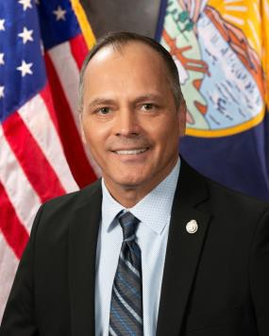
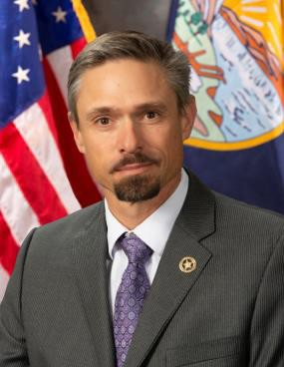
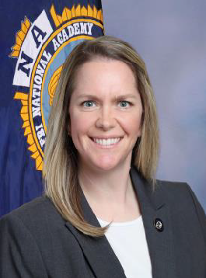
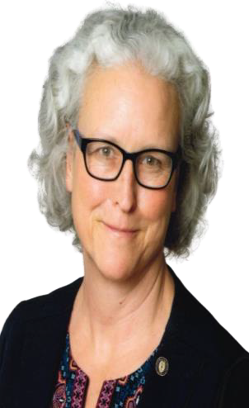
Lee Johnson
Administrator
Operations (Finance)
Investigations Bureau
Narcotics Bureau
Crime Information Bureau
Special Services Bureau
Vacant
Steve Crawford
Anne Dormady
Dana Toole

Slide 3
Administrator
(Lee Johnson)
Operations Officer (Finance)
Investigations Bureau
(Vacant)
Special Services Bureau
(Dana Toole)
Fire Marshal
Criminal Major Case Section
Medicaid Fraud
Office of Consumer Protection
General
Narcotics
Diversions
Interdiction
CJIN/Missing Persons
Criminal Records Section
Sexual & Violent Offender Registry
Child & Family Ombudsman
Looping in Native Communities
Intensive Behavioral Center
Montana Child Sexual Abuse Response Team
Sexual Assault Nurse Examiner Program (SANE)
Office of Victim Services
Computer Crime (Forensics & Cyber)
Sexual Assault
Kit Initiative
Internet Crimes Against Children
Social Security Fraud
Crime Information Bureau
(Anne Dormady)
Butte Task Force
Miles City Task Force
Human Trafficking Investigations
State Fund Investigations
Narcotics Bureau
(Steve Crawford)
MATIC Fusion Center
Elder Abuse
Montana Missing Indigenous Persons Task Force
Drug Intelligence Officer
Organized Retail Crime
148 FTE
68 SWORN
53 NON-SWORN
21 GRANT-MODIFIED
6 VACANCIES

Slide 4
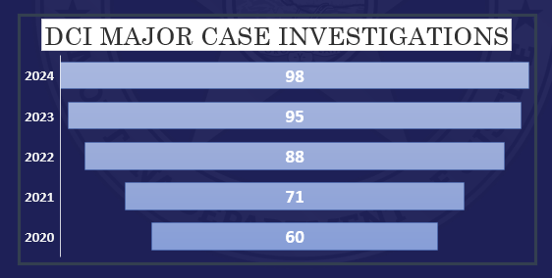
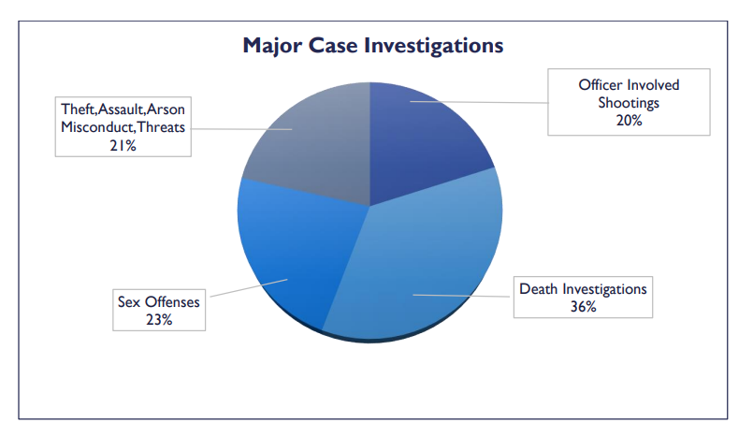
Division of Criminal Investigation (DCI)

Slide 5
Major Case Accomplishments and Efficiencies
3 FTE Agent Positions added (Kalispell, Great Falls, Billings)
Western Montana CIRT (12 County coverage)
HB 705- Suicide by LE intervention
Detective Academy (Boot Camp for local agencies)
Improved Crime Scene Processing Technology
Leica 3-D Crime Scene Scanner
Full-Spectrum camera technology
Drone imaging (aerial photography)
Cutting edge technology for locating buried remains
Notes:
Added 3 Major Case Agents last session (2 general, 1 Organized Retail Crime
Funded Elder Justice Unit- 1 Prosecutor, 1 Agent

Slide 6
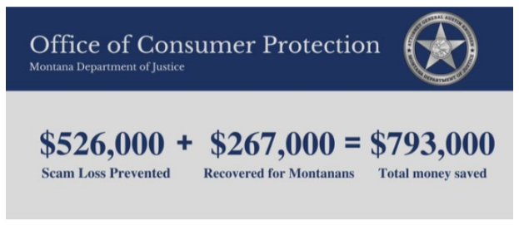
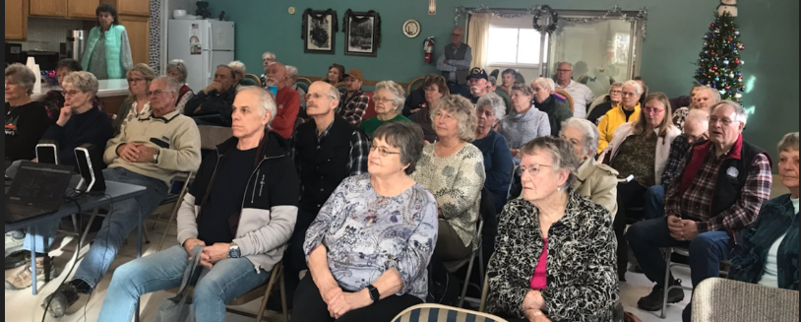
Investigations Bureau cont’d.
Office of Consumer Protection
Elder Justice Unit
Community Education: Public Outreach, Civic Groups, Town Halls, Public Safety
Direct Assistance to Law Enforcement/Prosecutors
Investigative Intervention- disrupt the scam or abuse
Resources- Use of Regional/National Partners- RMIN, ASCIA
Notes:
Elder Justice: Since inception opened: 71 Investigations/13 cases moved into prosecution stages. 63 assists to local LE or Prosecutors
14 Public Outreach or Local Training Programs
Monthly meetings with APS and Deconfliction with Medicaid Fraud Unit.

Slide 7
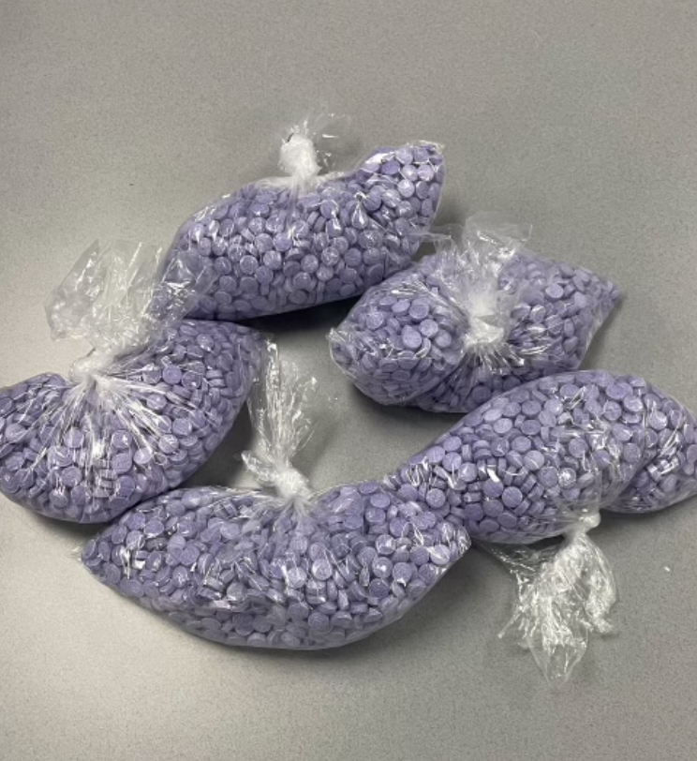
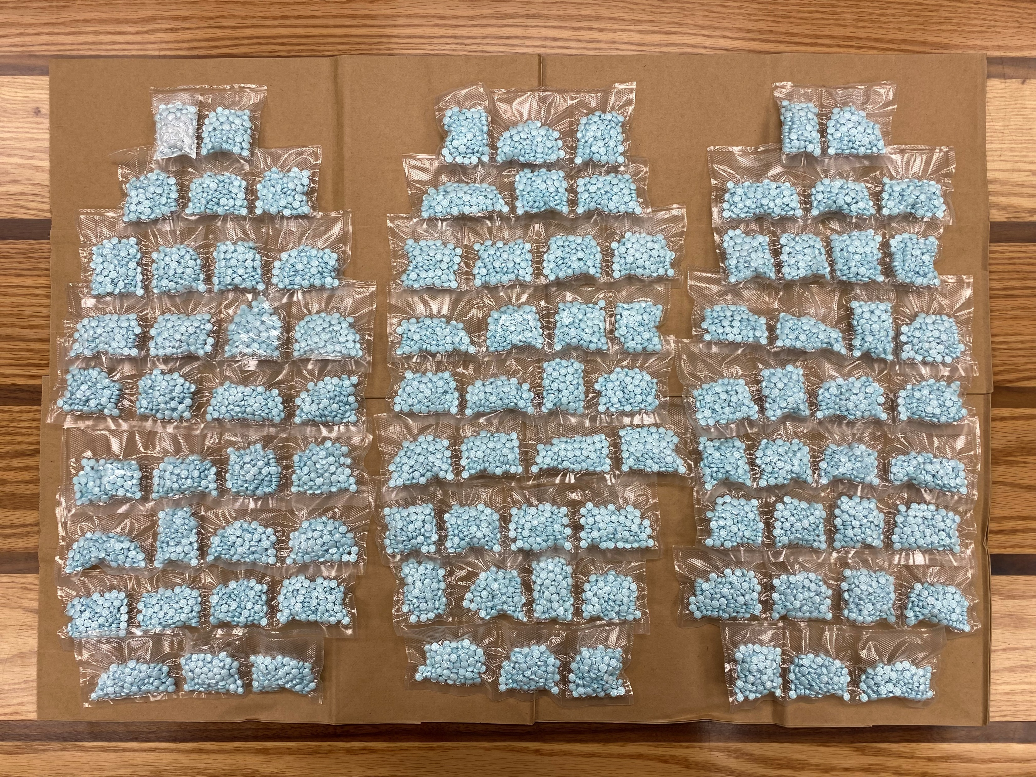
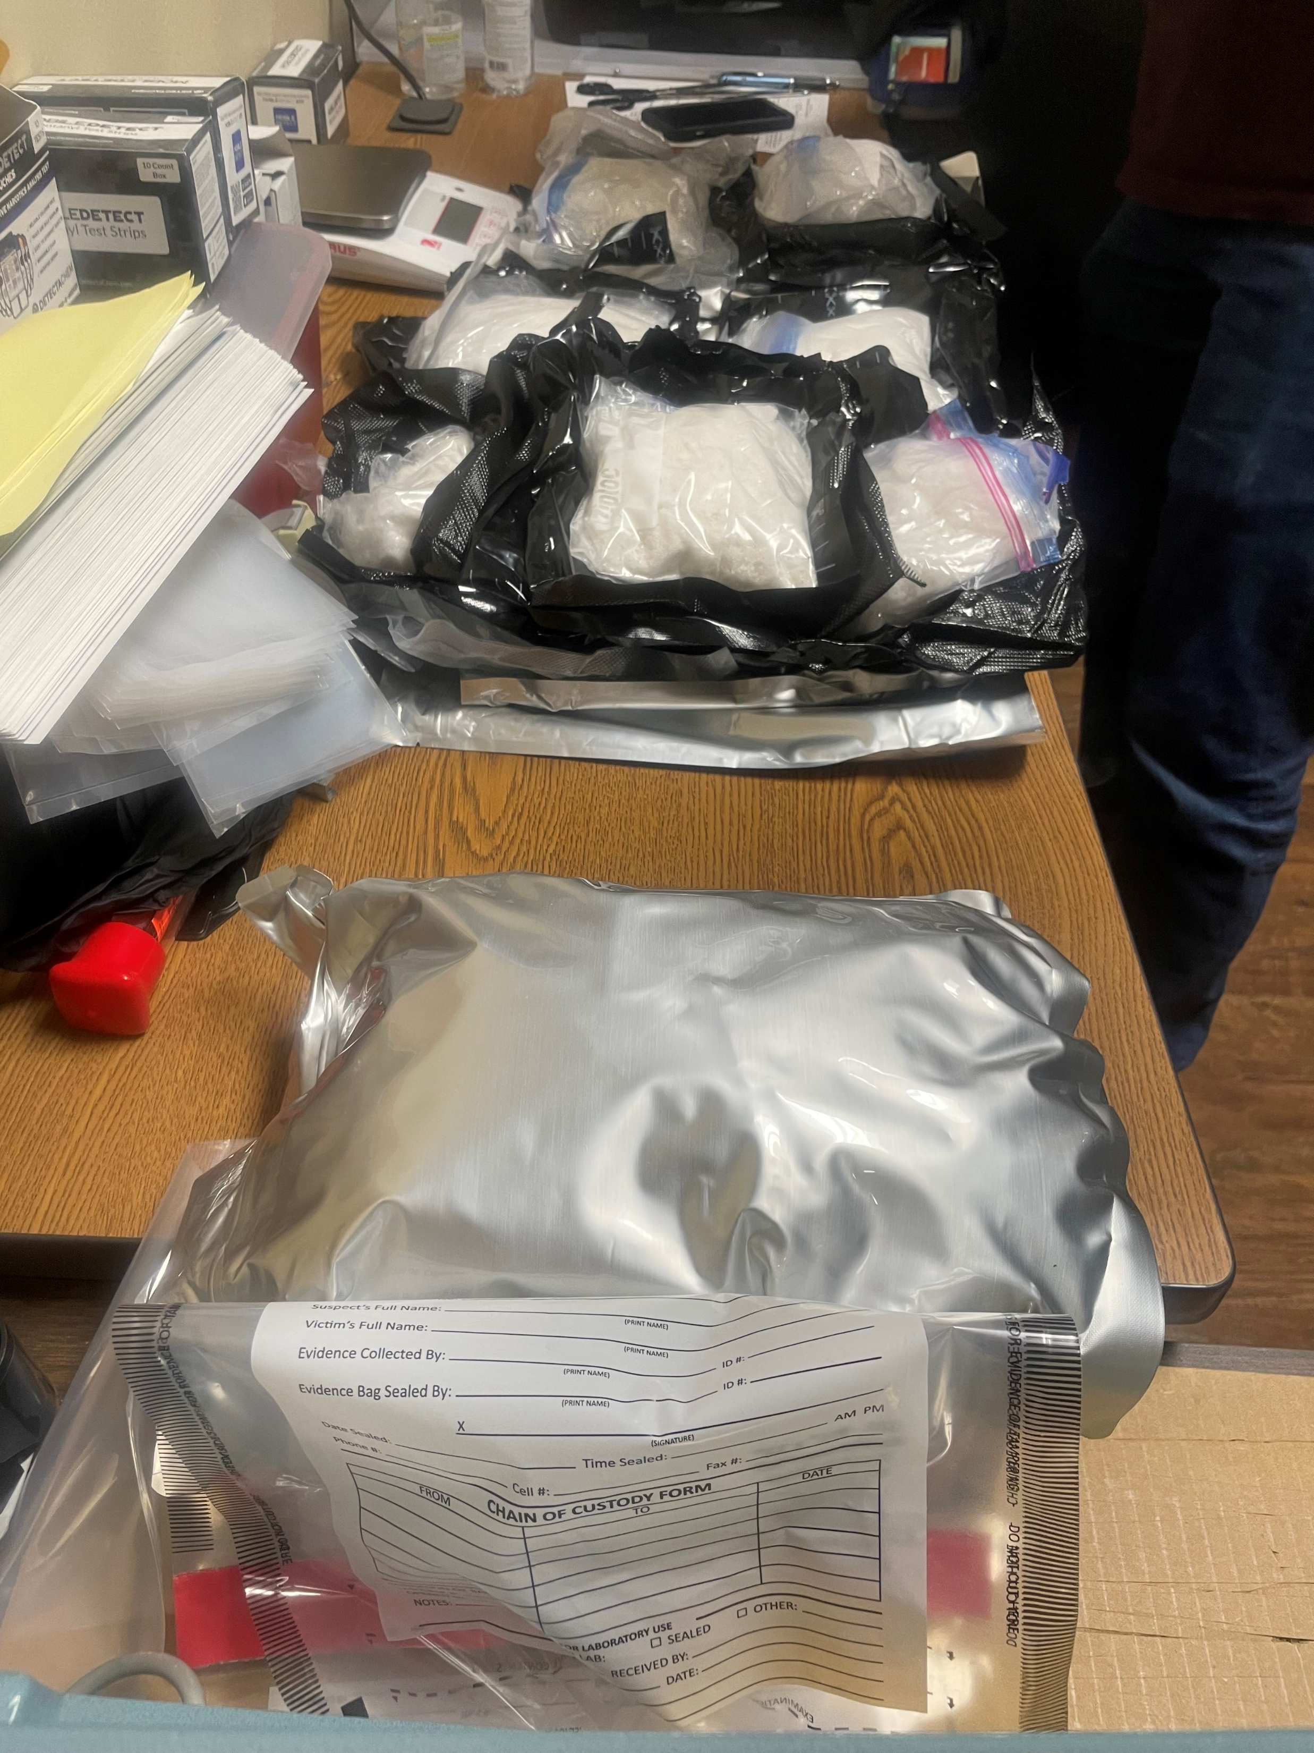
Narcotics Bureau
Fentanyl Methamphetamine Cocaine
Complex Conspiracy Investigations
Interdiction
Operations
Diversion Cases

Slide 8
Narcotics Bureau Accomplishments and Efficiencies
Increased coverage statewide- added positions in Havre, Sidney & Bozeman
DCI Agent positions filled on every Byrne-JAG funded and RMHIDTA Task Force
Disrupted & dismantled numerous DTO’s with local/state/federal collaboration
Modernized training, tactics and equipment
ARPA-funded investigative initiative targeting drug-trafficking/violent crime
Billings/Project Safe Neighborhoods
Assisted numerous agencies with overdose tracking & community response plans
OD Spike Map
Received National HIDTA Award for outstanding public health/public safety collaboration
Notes:
Havre, Sidney and Bozeman have been filled by DCI since last session.

Slide 9
Notes:
Meagher, Petroleum, Judith Basin and McCone Counties

Slide 10
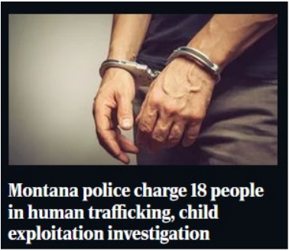
Human Trafficking
Commercial Sex Trade Industry
Labor Trafficking Investigations
Proactive operations target the buyer
John operations
Illicit massage businesses
Victim recovery operations
Intelligence networks building
Human Trafficking Reports:
2022: 106
2023: 147
2024: 129
Victim Services Specialist
Notes:
Added one Agent and one Victim Services Specialist last session.

Slide 11
Crime Information Bureau
TECHNOLOGY-DRIVEN RESOURCES
Computer Crime Unit
Internet Crimes Against Children
MATIC
Sexual & Violent Offender Registry
CRISS/CJIN
Notes:
Computer Crime- received 1 Agent last session
Analyst position from MATIC reassigned to assist Unit
All 3 Positions forensically certified

Slide 12
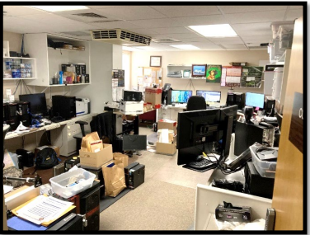

Slide 13
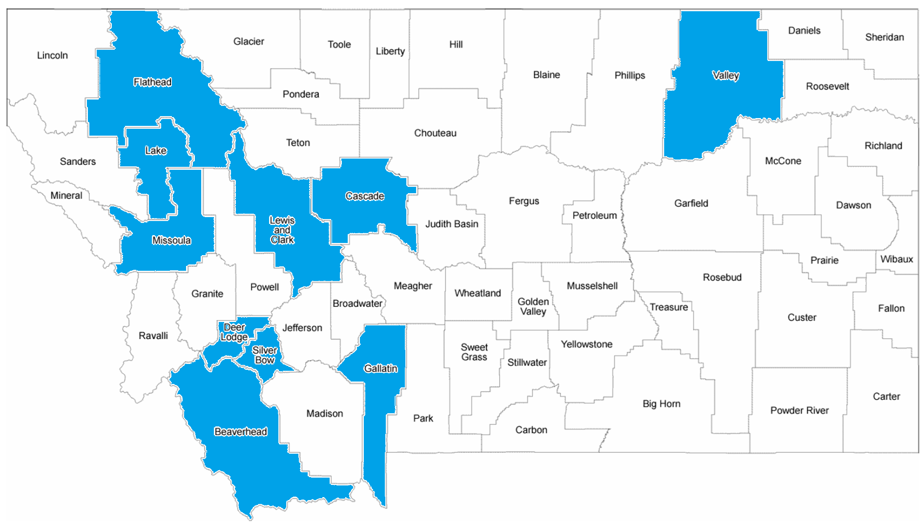
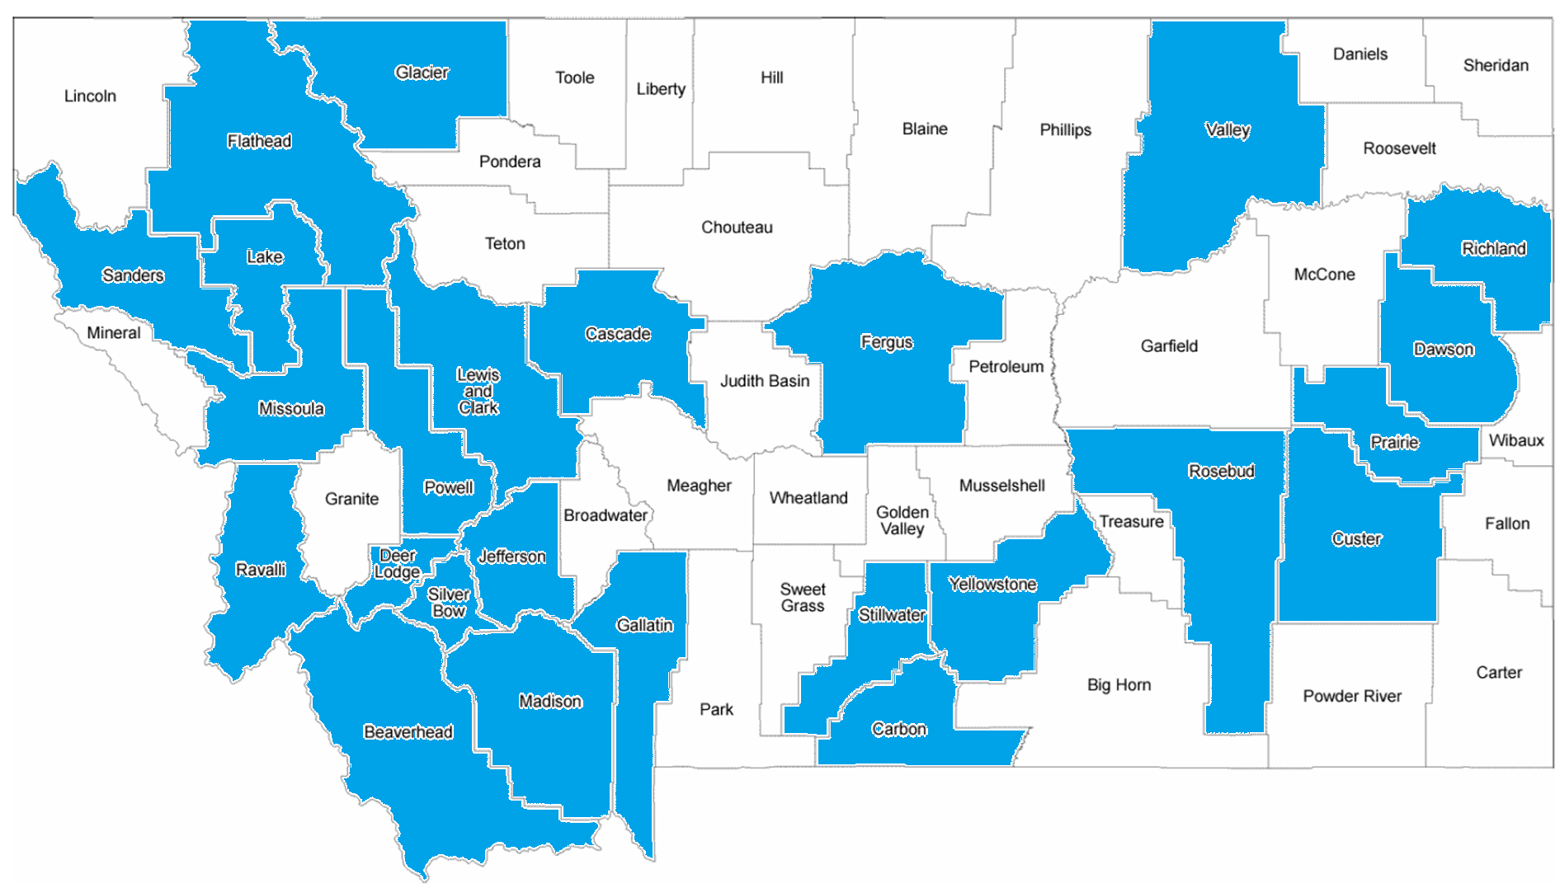
Crime Information Bureau Accomplishments and Efficiencies
All Agents and Analyst are now forensically-certified as computer crime examiners
Doubled the number of ICAC Affiliates from 17 to 34 counties
17 ICAC Affiliate Agencies during the 68th Session
34 ICAC Affiliate Agencies during the 69th Session
SVOR Montana State Registry (MSR) no longer has a backlog- real time updates
Increased number of operational successes with public safety partners
Current number of offenders (as of 01/03/2025) is 7,050 (3,851 violent offenders, 3,068 sexual offenders, 131 sexual & violent offenders))
Notes:
January 2024 just 1 certified. January 2025 all 3 are certified.

Slide 14
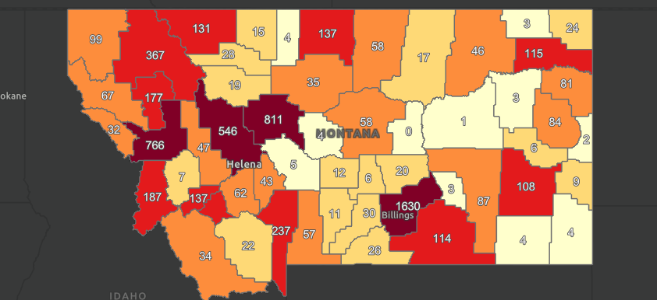
MSR Shares Information on 7,050 Registered Offenders

Slide 15
Special Services Bureau
Crime Victim Support & Resources
Office of Victim Services (OVS)
Montana Child Sexual Abuse Response Teams (MCSART)
Office of Child and Family Ombudsman (OCFO)
Sexual Assault Response Network (SARN/FREPP)
Sexual Assault Kit Initiative (SAKI)
Montana Missing Indigenous Persons Task Force (MMIP)
Intensive Behavioral Center Residential Investigations (IBC)
Looping in Native Communities (LINC)
Notes:
OVS has 6 main programs: Crime Victim Compensation, Crime Victim Restitution, Hope Card Program, Address Confidentiality Program, DVFR Commission, ELF Program

Slide 16
Special Services Bureau Accomplishments and Efficiencies
SAKI Grant resourced with a Crime Analyst and Cold Case Agent
2023 Legislative Session Impacts:
HB79- SARN Program- Improve statewide access to trained sexual assault nurse examiners
DCI sponsored statewide training- 49 health care professionals attended
DCI hosted sexual assault prosecutions training- 46 prosecutors attended
HB18- Missing Person Response Team Training Program
DCI held 3-day Emergency Search Training- 5 Tribal Agencies and 4 Local/State Jurisdictions attended
HB183- Raised cap for allowed homicide victim funeral benefits from $3,500 to $10,000
To-date 74 awarded claims totaling $336,540.67
SB522- Established fund for emergency lodging for survivors of human trafficking and domestic violence (ELF)
Current Balance $80,000 (incoming success with lodging agreements)
Notes:
January 2024 just 1 certified. January 2025 all 3 are certified.
74 awarded claims date back to March 23, 2023

Slide 17
Division Advancement…
Continued focus on Fentanyl Crisis/Human Trafficking/Violent Crime
Implementation of Case Management System (ACISS)
Go-Live January 1, 2025
Evidence Module Enhancement
Computer Crime Lab Improvements and Backlog Reductions
Fire Marshal Inspection Software and Tablets
BERLA motor vehicle forensic software tool
MATIC continued support for statewide public safety
Program outreach, education, training & certifications
Notes:
Added 3 Major Case Agents last session (2 general, 1 Organized Retail Crime
Funded Elder Justice Unit- 1 Prosecutor, 1 Agent

Slide 18
Goals and Metrics
Fully implement all legislative resources 2021/2023 (90%)
Continued monitoring of marijuana black market (25%)
Develop additional Regional CIRT Teams (33%)
Obtain Computer Crime Unit accreditation (15%)
Reduce unnecessary workflow- witness interview transcriptions (50%)
Statutory amendments:
HB 82- Revise Crimes Against Children
HB 104- Concurrent Jurisdiction in Human Trafficking, Prostitution, ICAC
Elder Justice clean-up
Align spending authority for CJIN/CRISS Services (0%)
Notes:
Added 3 Major Case Agents last session (2 general, 1 Organized Retail Crime)
Funded Elder Justice Unit- 1 Prosecutor, 1 Agent

Slide 19
Division Budget Fiscal Year 2025

Slide 20
Budget Requests
Notes:
DP 1 - Personal Services - The executive requests adjustments to the present law personal services budget. This request has been broken into the following categories, and further detail is shown in the agency summary: • Legislatively approved changes • Management decisions • Budget modifications made to the personal services budget in the 2023 biennium
DP 2 - Fixed Costs - The executive requests adjustments to provide the funding required in the proposed budget for fixed costs assessed by other agencies within state government for the services they provide. Examples include: warrant writer, motor pool, information technology services, etc. The rates charged for these services are approved in the section of the budget that provides the services. All DOJ fixed costs are being moved to Central Services.
DP 3 - Inflation Deflation - The executive requests adjustments to reflect budgetary changes generated from the application of inflation and deflation factors to specific expenditure accounts. Affected accounts include: motor pool

Slide 21
Division of Criminal Investigation QUESTIONS ?
Lee Johnson, Administrator
Montana Division of Criminal Investigation
2225 11th Avenue
Helena, MT 59601
LJohnson@mt.gov
Phone: 406-444-3874

