Slide 1
Gambling Control Division Administrator Jason Johnson
January 2025 Section D Budget Presentation

Slide 2
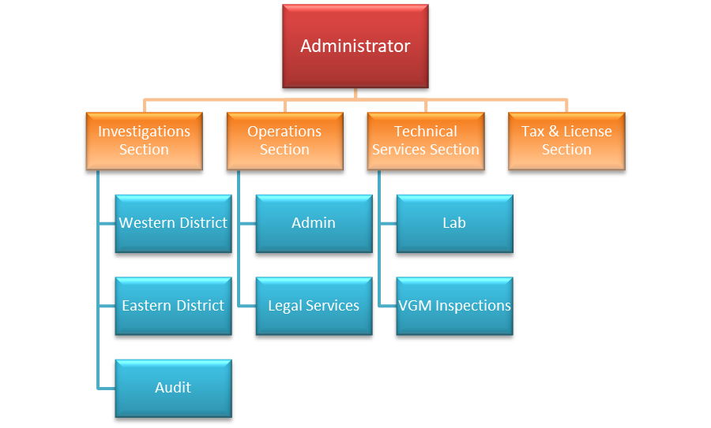
34 FTE
7 Offices:
Billings - HQ
Helena – Lab
Missoula
Kalispell
Great Falls
Bozeman
Glendive
Notes:
*Go over office location
INVESTIGATIONS SECTION (13 sworn LEOs)
- Help businesses navigate gambling, alcohol and tobacco regulations
In person visits through routine inspections and case work for new and changing businesses.
Conduct criminal background checks for alcohol and gambling license applications.
Investigate complaints for gambling alcohol and tobacco. Findings reported back to alcohol and tobacco.
Outreach and Education – *(Describe efforts and launch) - Veterans and Fraternal organizations proactive project
AUDIT (5)
- Conduct complex financial audits on alcohol and gambling cases.
We make sure owners are disclosed and dark money stays out of Montana.
OPERATIONS
– Operations Manager
– Administrative Officer (Fiscal notes)
– Attorney
TECHNICAL SERVICES (6)
– Lab Supervisor (+operations)
- 2 Programmers
2 VGM Inspectors that cover the state ensure approved software is being used.
They also help investigate complaints regarding VGMs
2 Software engineer's – complete testing on any VGM getting approved
WELCOME TO TOUR THE LAB ANYTIME
***The lab closed 54 testing cases in FY23 and 70 cases in FY24 for new gambling devices or software modifications. The average turnaround time on video gambling machine modifications was 16 days in FY23 and 13 days in FY24. The laboratory is primarily supported by hourly testing fees ($130) that are paid by the video gambling machine manufacturers.
TAX & LICENSING
Usually our first point of contact – Customer service driven
Process and issue gambling licenses and permits
Collects fees and maintain license records
Collects gambling taxes, fines and penalties

Slide 3
Gambling Control Division
The mission of the Gambling Control Division (GCD) is to create and maintain a uniform regulatory climate to protect the businesses, players, organizations, citizens, and all who are affected by legalized gambling in Montana.
1989 – The legislature centralized gambling regulation under the Department of Justice, taking the burden off local governments.
1987 - The legislature enacted a 15% tax on video gambling machines.
*FY24 – 15% tax for VGM’s = $83.7 m (4% increase from FY23)
The gaming industry plays an important role in the health of Montana’s overall general budget.

Slide 4
Gambling Control Division
The Gambling Control Division’s jurisdiction
Video gambling machines - keno, poker, bingo, or line games;
Live card games;
Live bingo and live keno;
Sports pool and sport tab games;
Calcutta pools;
Casino nights;
Raffles;
Shake-a-day dice game;
Live fantasy sports leagues; and
Fishing derbies and betting on natural occurrences
… and yes, even Heads or Tails

Slide 5
Gambling Control Division
GCD does not regulate:
Horse Racing - Dept. of Commerce
Tribal Gaming – Compacts/Governor’s Office
Sports Betting or Lottery – Montana Lottery/Dept. Administration

Slide 6
The DOJ/GCD Approach
Under the AG’s leadership, one of our priorities is to be a resource not an adversary for Montana businesses.
If we can help a business achieve compliance, we do it. Minor issues can be corrected during a compliance investigators visit.
We watch for and deal with “Bad Actors.”
28 Gambling Legal Cases in FY24. (15 in FY23)
Notes:
I am proud to say that we have a very good reputation among Montana businesses we work with and that has not always been the case.
For the past 4 years we have made customer service to Montana businesses as a top priority. We want to see businesses that operate in this industry succeed.
“MINOR ISSUES EXAMPLE – AGE PLACARDS

Slide 7
MOU’s
Alcohol
-Alcohol and Gambling combined application processing
-Financial audits
-Criminal background investigations
-Routine and case related suitability inspections
-Investigate complaints
Tobacco
-Conduct complaint investigations as needed.
-Ensure settlement conditions are met with approved brands being sold.
Lottery
Conduct criminal investigations upon request.

Slide 8
2,209 inspections
Notes:
*** Tobacco inspections happen daily and throughout the state as part of our routine compliance inspections.
In calendar year 2024 2437 inspections of alcohol, gambling and tobacco establishments were completed by GCD compliance investigators.

Slide 9
Goals & Performance Prevent Online Gambling
The issue:
• It is illegal in Montana
• Generates untaxed gambling revenue
• No consumer protection for Montana with unregulated platforms
• Undermines licensed Montana gambling businesses
Legislative approach:
• Work with the industry to help introduce a bill that increases penalties for companies offering illegal gambling and further clarify the description of prohibited online gaming, specifically sweepstakes style casinos. Many of which come from offshore companies.
Investigative / Enforcement approach:
• Seek out companies offering these types of games and execute cease-and-desist orders.
• Communicate and partner with other states fighting this issue. We have joined the National Gaming Intel Sharing Group and will continue to seek and share information about legal action being taken against companies, both foreign and domestic, that offer these illegal games.
Notes:
Recently partnered with 5 other states to send a cease-and-desist order to a large scale offshore online gaming company.

Slide 10
Goals & Performance Increase Efficiencies Between GCD & ABCD
GCD works with Alcohol Beverage Control to update our joint procedure manual. This helps address redundancies and inefficiencies when processing applications between the two agencies. This is an ongoing process.
In FY24, GCD/ABCD held 16 joint management meetings. These meetings provide opportunities to address communication issues and problem cases.
Notes:
We get build out our goals based on what the hot topics of the industry are.
We welcome your feedback on future GCD goals based on what you hear from your constituents.

Slide 11
2023 Legislative Changes – Update
Minimal gambling law changes last session.
HB297 – Revised video gambling machine taxes to allow a deduction for loses.
FY24 = ($562,019.00) of deducted losses.
FY25 1st Quarter = ($183,543.00
*FY24 – 15% tax for VGM’s = $83.7m (4% increase from FY23)

Slide 12
Gambling Control Division Budget
Notes:
Describe Revenue Sources
*DON’T describe MOU’s yet

Slide 13
Budget Requests
Notes:
DP 1 – Personal services- The executive requests adjustments to the present law personal services budget. This request has been broken down into the following categories and further detail is shown in the agency summary: Legislatively approved changes, management decisions, budget modifications made to the personal services budget in the 2025 biennium.
DP 2 – Fixed Costs – The executive requests adjustments to provide the funding required in the proposed budget for fixed costs assessed by other agencies within state government for the services they provide. Examples include: warrant writer, motor pool, IT services, etc. The rates charged for these services are approved in the section of the budget that provides the services. DOJ is combining all fixed costs under the Central Services Division for efficiency.
DP 3 – Inflation/Deflation – The executive requests adjustments to reflect budgetary changed generated from the application of inflation and deflation factors to specific expenditure accounts. Affected accounts include motor pool costs.

Slide 14
Gambling Control Division
For more information, please visit our website at dojmt.gov/gaming
Guidelines & Templates for a variety of gaming activities
Problem Gambling Resources / MT Council of Problem Gambling
Gambling Statistics & Reports
Stats by Quarter
Biennial Reports
Licensed Gambling Businesses
VGM Reports
Annual Performance Report at dojmt.gov

Slide 15
Gambling Control Division
Jason Johnson
GCD Administrator
Department of Justice
jason.johnson@mt.gov
406.329.1478

