Slide 1
Montana Board of Crime Control
Section D Budget Presentation
January 2025
Natalia Bowser | Director

Slide 2
MBCC Mission
Proactively contribute to public safety, crime prevention and victim assistance through planning, policy development and coordination of the justice system in partnership with citizens, government, and communities.

Slide 3
MBCC Overview
The MBCC Board was created in 1968 as a planning and research agency under the authority of 2-15-2008, designated in Montana as the State Administering Agency for U.S. DOJ funding.
The Board is an 18-member quasi-judicial Board appointed by the Governor.
Oversees grant funding awarded or appropriated by the US DOJ and the Legislature to support and improve the criminal justice system.
Houses the Statistical Analysis Center, which collects and analyzes MT criminal justice data for the FBI, policy makers, and the public.
Works on criminal justice policy and planning efforts to contribute to improving the criminal justice system in Montana.
Manages and supports the Youth Justice Council, which is a 15-member Council appointed by the Governor and is advisory in nature on Juvenile Justice issues for the MBCC Board.

Slide 4
MBCC Strategic Goals, 2024-2025
Goal 1: Support efforts to improve criminal justice data collection and sharing across the state.
Goal 2: Support prevention and reduction of crime through education, enforcement, and interventions.
Goal 3: Provide opportunities and resources to strengthen and sustain victim services at the program and community level.

Slide 5
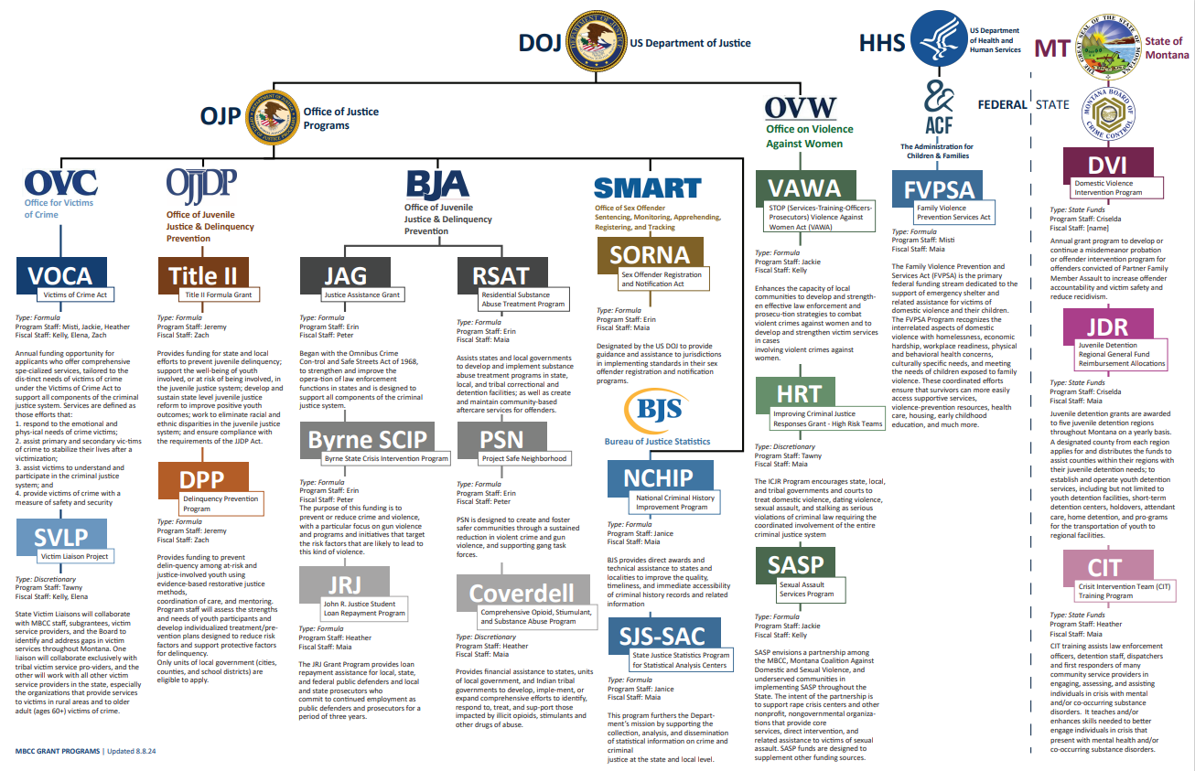
MBCC Grant Programs

Slide 6
MBCC Leadership Team
Montana Board of Crime Control
Natalia Bowser
Director
Criselda DeLaCruz
Grant Program Manager
Tammy Farris
Grant Financial Manager
Janice Fries
Statistical Analysis Director
Oversees grant operations for MBCC
Identifies and applies for federal grants
Supports and monitors subgrantees
Provides training and technical assistance
Oversees financial operations for MBCC
Prepares budgets and monitors expenditures
Supports and monitors subgrantees
Provides training and technical assistance
Serves as the MT Statistical Analysis Center
Collects crime and law enforcement statistics
Manages the Criminal Justice Data Warehouse
Provides training and technical assistance

Slide 7
MBCC Organizational Chart
Executive Assistant
Administrative Officer
Montana Board of Crime Control
IT Administrator
Victim Services Liaison
Natalia Bowser
Director
Grant Financial Manager
Grant Program Manager
Statistical Analysis Director
Budget Analyst II
Grant Coordinator
Public Safety
Data Warehouse Architect
Budget Analyst I
Grant Coordinator
Victim Services
Data Integrity Analyst
Grant Accountant
Grant Coordinator
Victim Services
Data Integrity Analyst
Grant Accountant
Grant Coordinator
Juvenile Justice
Grant Accountant
21 FTE
HB2: 18
Modified: 3
Grant Coordinator
Public Safety & Victim Services
Grant Accountant

Slide 8
MBCC Accomplishments
Awarded and managed $4 million dollars provided in the 2023 legislative session to victim services providers across the state
Supported 200+ programs crucial to law enforcement, victim services, juvenile justice, and the courts through grant awards, grant management, and grant monitoring.
Achieved 100% participation on the annual Law Enforcement Survey - for the 4th year in a row
Completed statewide victim services needs assessment and created a statewide map of victim services resources
Began implementation of the Criminal Justice Data Warehouse as required in 44-7-126
Leading efforts on creating automated entry for data collection by entities
Successfully transitioned the Family Violence Prevention Services Program from the Department of Health and Human Services
Completed two federal audits for review and management of federal funds, with no findings
Held annual Crime Prevention Conference bringing together partners across the criminal justice system

Slide 9
MBCC Appropriated Budget
2024-2025 Appropriated Budget, by Fund Type
2024-2025 Appropriated Budget, by Budget Category

Slide 10
MBCC Decision Packages
 | General Fund Total | Total Funds
FY 2026 | $0.00 | $2,000,000
FY 2027 | $0.00 | $2,000,000
NP – 2102 – Move OTO VOCA funding to permanent The Montana Board of Crime Control received $4,000,000 in OTO pass-through in the 2023 session. This money is needed to make up for a reduction in VOCA federal funding for Victims of Crime. Funding is contingent on passage and approval of legislation creating and funding the new Victims of Crime State Special Revenue Fund.

Slide 11
Natalia Bowser, Director
https://mbcc.mt.gov

