Slide 1
Montana Highway Patrol (MHP)
Administrator: Colonel Kurt Sager
January 2025
Section D Budget Presentation
Notes:
Rules of Template Design:
Please do not change the font style or color
Please do not use font size less than 14pts
Please do not overcrowd the slide
Please make sure pictures and graphics are high-quality and not pixelated
Please keep content high-level

Slide 2
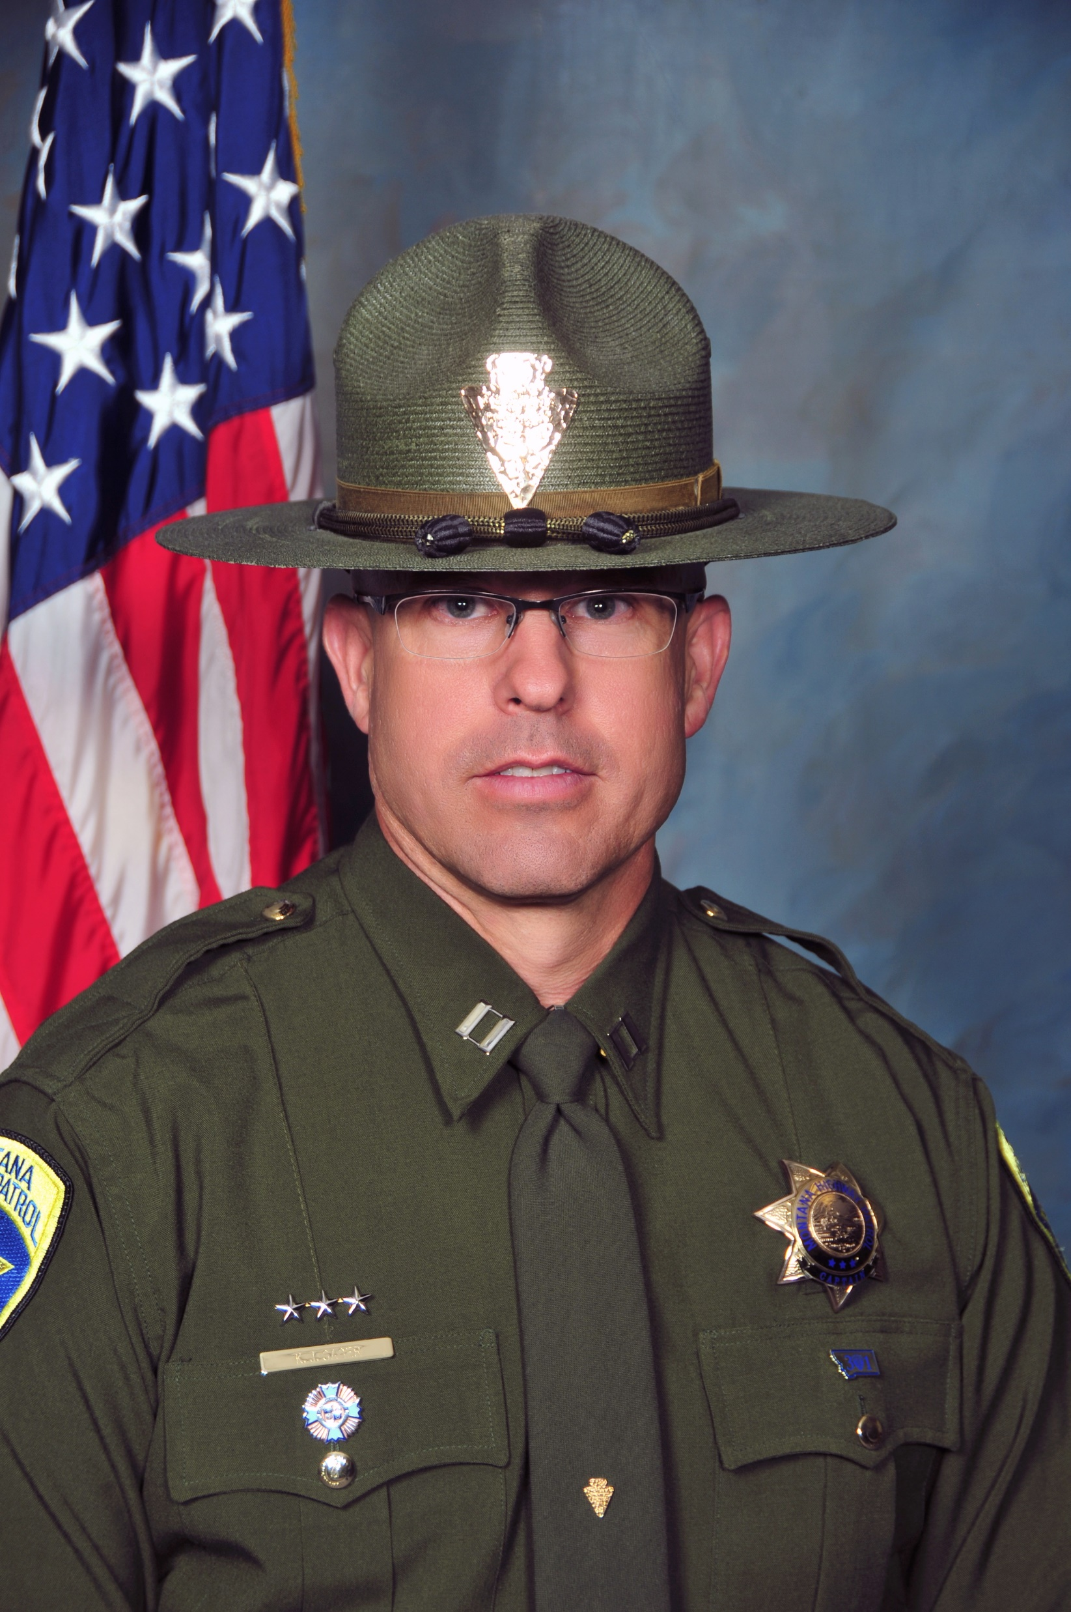
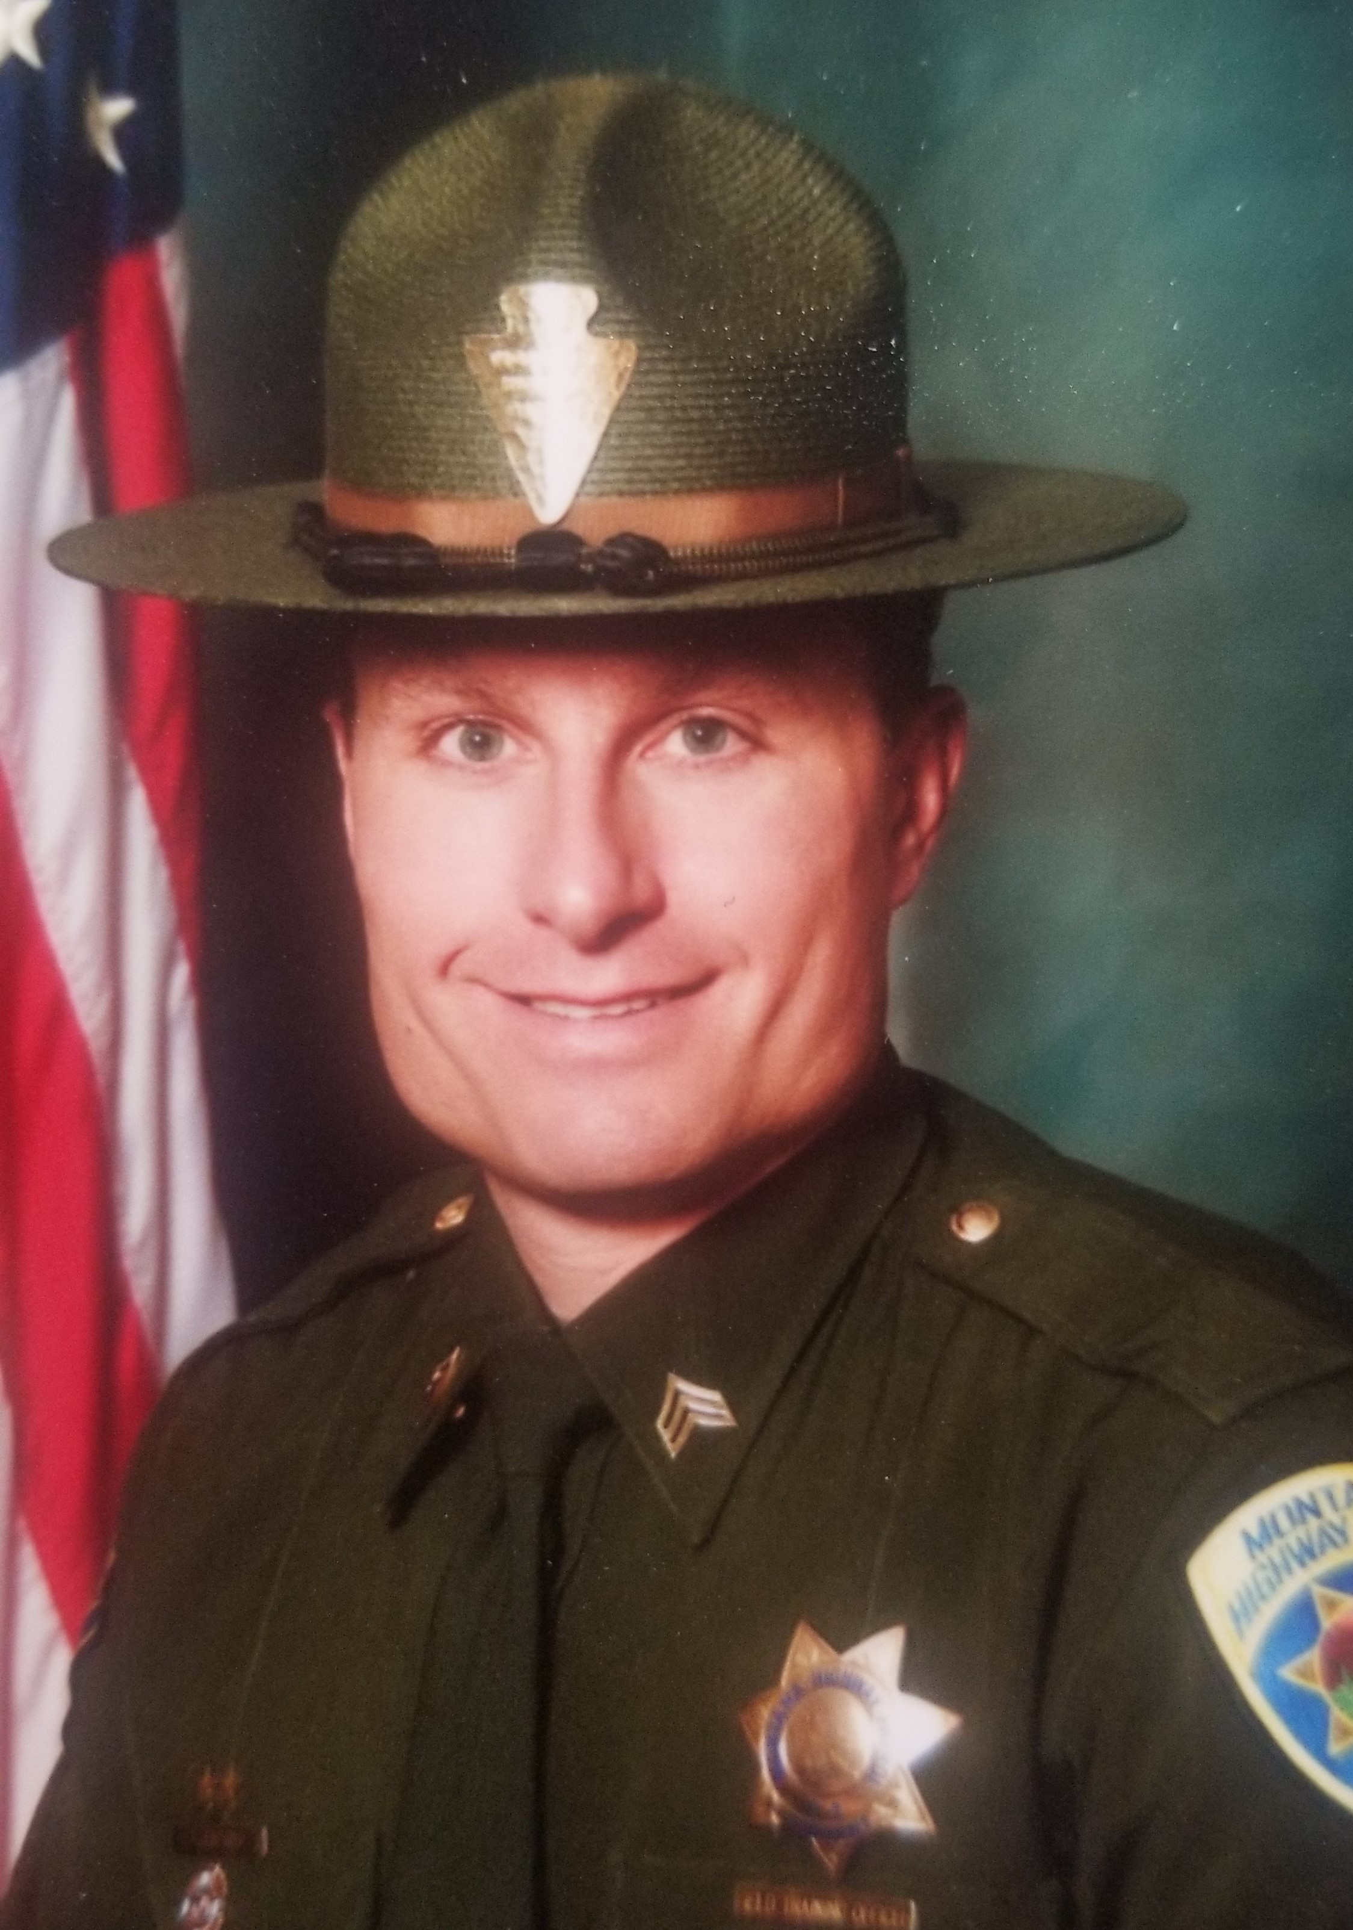
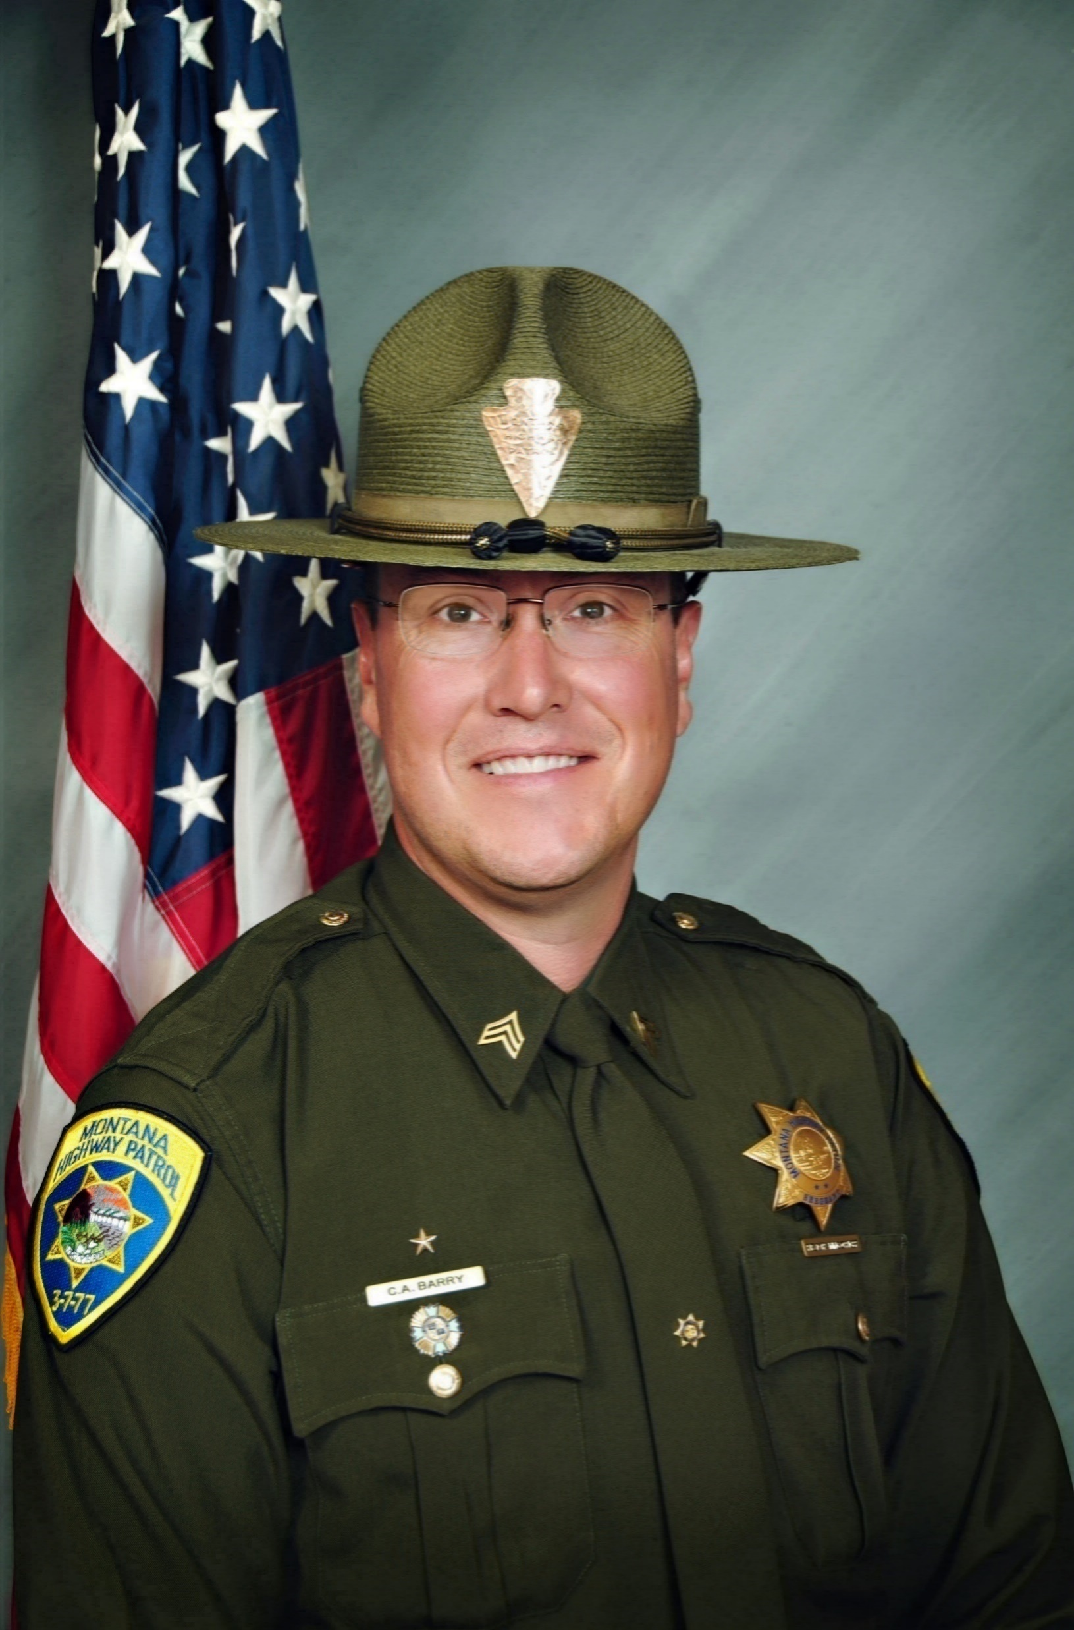
Montana Highway Patrol Org. Chart
Administrator
Colonel Kurt Sager
Operations
Major Chan Barry
Field Forces
LTC Kyle Hayter
Notes:
Should be a high-level Org Chart with pictures. Typically, this would be the division administrator and all direct reports.

Slide 3
Montana Highway Patrol Org. Chart
Colonel (Administrator)
Lieutenant Colonel
Operations Major
Western Major
Eastern Major
Professional Standards Captain
Executive Protection Captain
Technology Captain
Training Sergeant
Capitol Security Sergeant
Statewide Radio Manager
Strategic Enforcement Captain
Butte Captain
Missoula Captain
Academy Sergeant
Executive Protection Sergeant
MHP Radio Manager
Bozeman Captain
Dispatch Supervisor
24/7 Sergeant
IT Systems Analysts
Great Falls Captain
Billings Captain
Impaired Driving Sergeant
Administrative Officer
Operations Captain
Kalispell Captain
Glendive Captain
Maintenance Manager
Supply Sergeant
Records Sergeant
Traffic Homicide Sergeant
Notes:
This org chart should show departments, not people.
Include FTE List

Slide 4
Items of Interest
Pay and Retention
Budget Shortfall
New Funding Source
Notes:
Please do not overcrowd slide. Use multiple slides if necessary.

Slide 5
Drug Seizures
Seizure Type | 2023 | 2024
Cocaine/Crack Cocaine | 23.25 Pounds | 18.45 Pounds
Fentanyl | 49,936 DU/2.96 Pounds Powder | 109,463 DU & 1.06 Pounds Powder
Hallucinogen | 1.38 Pounds | 4.1 Pounds
Heroin | .35 Pounds | 12.46 Pounds
Marijuana & Marijuana Products | 3458.5 Pounds | 463.13 Pounds
Methamphetamine | 145.4 Pounds | 140.24 Pounds
Pharmaceuticals | 322.25 DU | 1,699.5 DU
Weapons | 67 | 42
**DU-Dosage Units=Number of Pills
Notes:
Prior to 2020 no fentanyl was reported seized. 8,367 doses seized between 2020 and 2021

Slide 6
Violent Crime
Source: Montana Board of Crime Control
*2024 numbers are not yet available
Notes:
mbcc

Slide 7
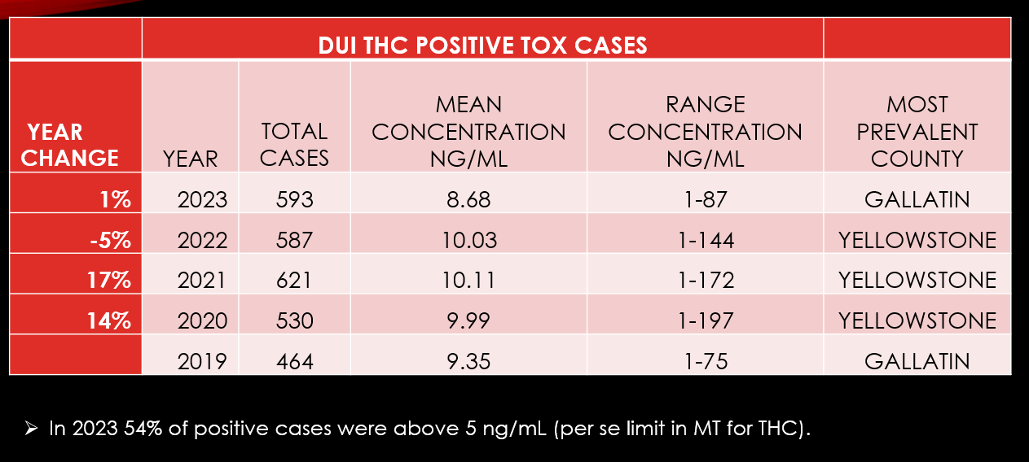
Marijuana in Montana
Source: Forensic Science Division
Notes:
Montana only stats

Slide 8
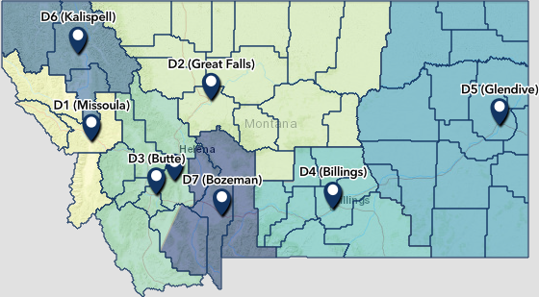
Population Growth
Kalispell 8.9% - District 6
Helena 7% - District 3
Bozeman 6.3% - District 7
Billings 3.9% - District 4
Missoula 3.7% - District 1
Butte-Silver Bow 3.5% - District 3
Source: US Census Bureau, 2020-2023 data
Notes:
Metropolitan and Micropolitan Statistical Areas Totals: 2020-2023

Slide 9
Travel & Tourism
Non-Resident Visitor Source: University of Montana Institute for Tourism and Recreation Research
Miles Driven Source: Montana Department of Transportation
*2024 numbers are not yet available
Notes:
11.9 miles driven through Oct 2024

Slide 10
Traffic Fatalities
*2024 numbers are not finalized

Slide 11
Annual Prisoner Per Diem Cost (Millions)

Slide 12
Accomplishments & Efficiencies
Added 2 Canine Instructors
Added 2 Counties to Statewide Radio
Upgraded Dispatch Center
Replacing Rifles
Replacing In-Car Cameras and Added Body Worn Cameras
Deployed Replacement Tasers
Hired Largest Cadet Class Since Salary Survey
Improved Radio Communications
Notes:
MDT partnership;
Hire large class

Slide 13
Goals & Metrics
Get to full staff (trooper and dispatch)
Replace old radios
Reduce Vehicle Mileage
Increase Officer Safety Equipment and Training

Slide 14
Ongoing Projects
Equipment Upgrade
In-car video and body-worn camera in the rollout stage
New Rifle rollout
Continued Radio Rollout
Statewide Radio Upgrades & Expansion
Campus Upgrades
Ongoing maintenance
Increased training technology and usage
Notes:
Statewide radio

Slide 15
Division Budget Fiscal Year 2025

Slide 16
Legislative Requests
Salary Survey
Retirement
Funding source
$400,000 for vehicles & equipment
$200,000 additional for in-car cameras and body cameras
Statewide Radio Loans
Notes:
Retirement funding is in HB85

Slide 17
Budget Requests
Notes:
NP 302 taken care of by HB85 this session

Slide 18
Budget Requests Continued

Slide 19
Montana Highway Patrol
Kurt Sager
Colonel
Department of Justice
ksager@mt.gov

