Slide 1
Motor Vehicle Division
January 2025 Section D Budget Presentation
Notes:
50 year anniversary March 6th.

Slide 2
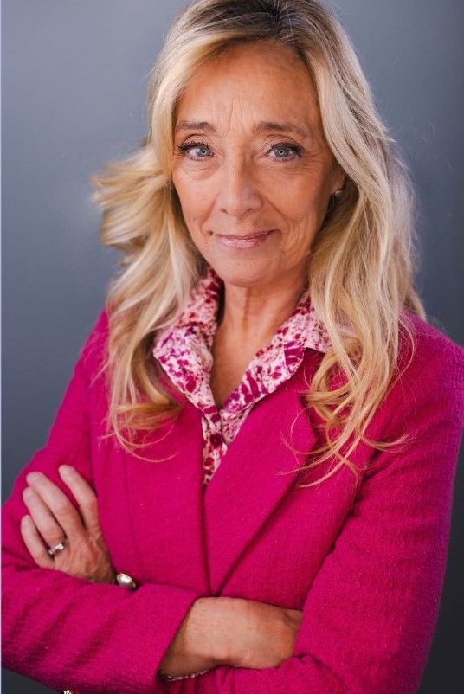
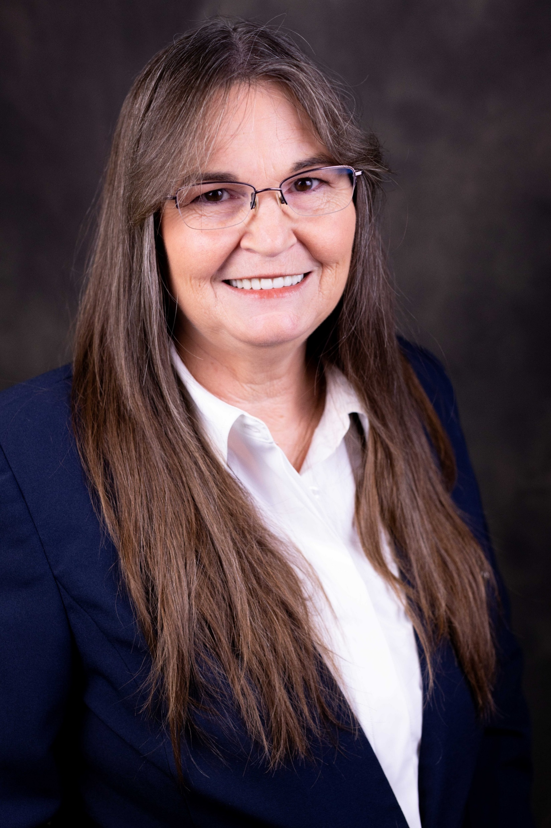
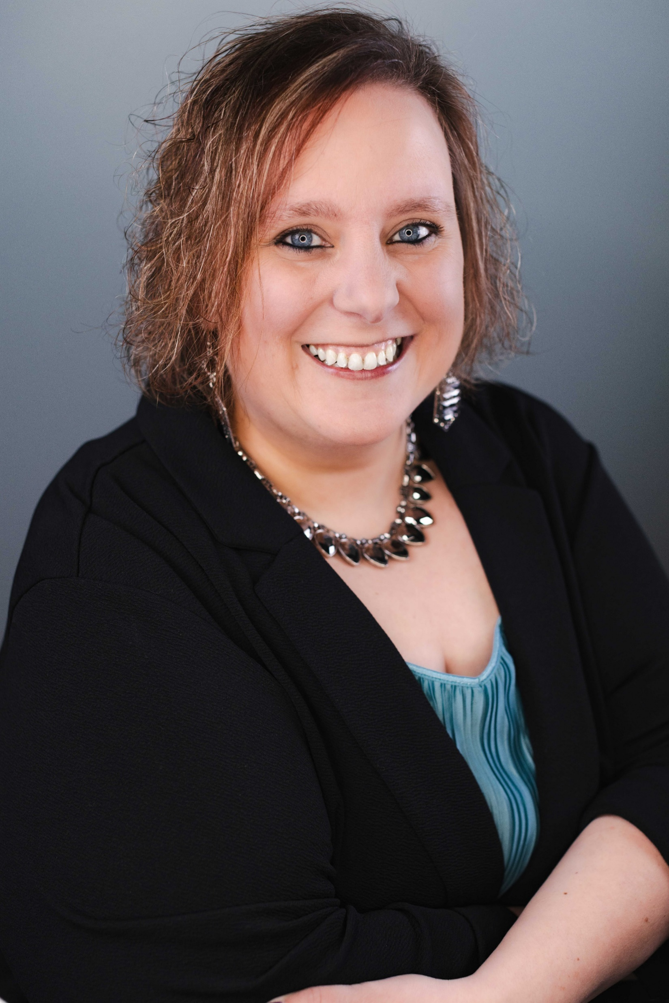
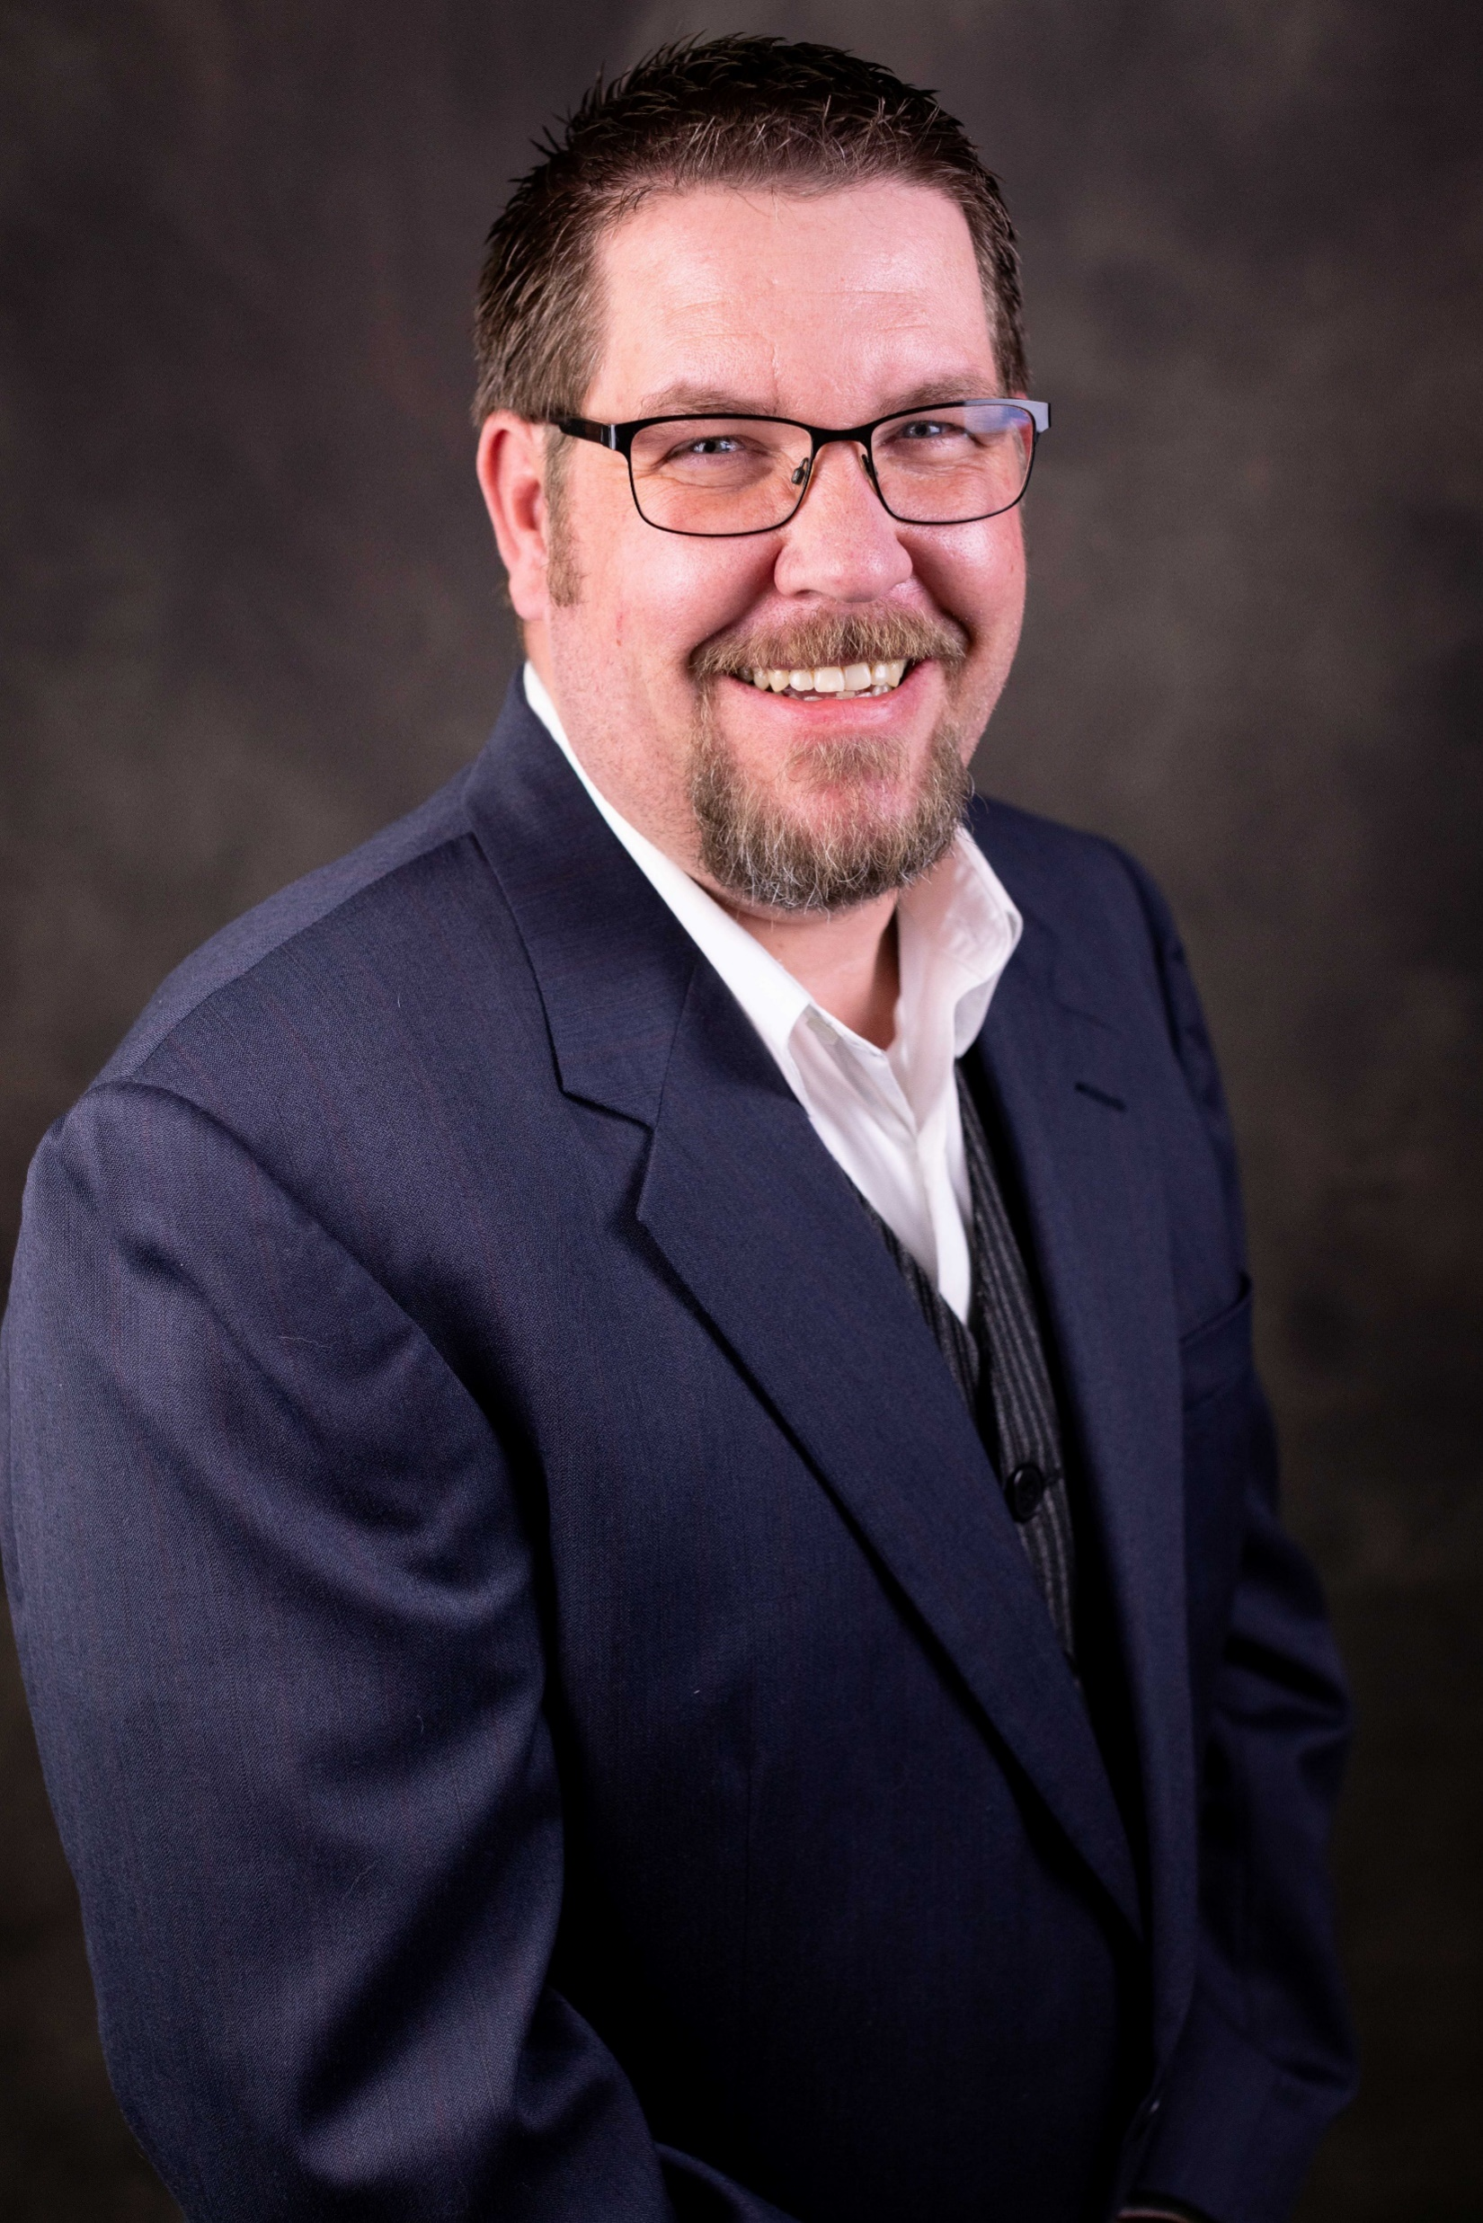
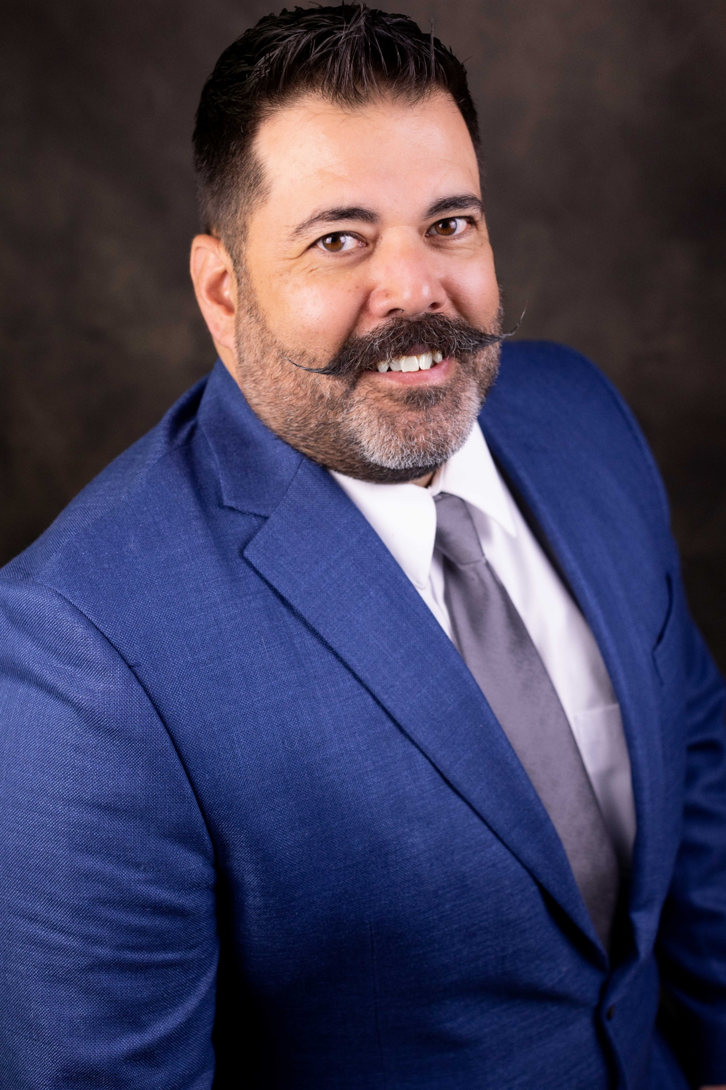
MVD Organization Chart
Administrator
Laurie Bakri
Operations
Felisha Koch
Fiscal
Karen Treharn
Driver Services Bureau
Tyson Miller
Vehicle Services Bureau
Michael Walker

Slide 3
MVD Organization Chart
Technical Writer
Administrator
Office Manager
Driver Services Bureau
Vehicle Services Bureau
Fiscal
Operations
Audit
Budget
Financial Operations
Testing
Training
System Maintenance
Authorized Agents
Call Center
Exam Stations
Commercial Unit
Medical Unit
Non-Commercial Unit
Title & Registration
Dealer Licensing
Salvage
Fleet
Dealer Compliance
Security Interests
Inventory

Slide 4
MVD Key Points
Our Mission – Driving Customer Service
48 Exam locations across the state
71 partner locations – county treasurer offices & authorized agents
Licensed Drivers
861,799 Standard License
50,886 CDL
Nearly 3.9M Registered Vehicles

Slide 5
MVD Accomplishments - 2024
CARS Rollout 2
Reduced appointment times from 22 minutes to on average 6 minutes per transaction.
Examiners can complete up to 30 transactions per day in comparison to the 12 – 15 prior to CARS
Wait times for appointments have decreased from 48 - 90 days to less than 7 days including remote locations, with all major locations having next day / same day appointments and walk in availability.
In nearly all Exam stations, the wait time to take a written or driving test has gone from 79 days to 6, a 92% decrease.
For individuals needing to renew their driver license or ID card in person, the wait has gone from 45 days to less than 3 days and in major locations same day, a 93% decrease.
Check-in Kiosks

Slide 6
MVD Goals for 2025
CARS Rollout 3
Services for the Public
Increasing online transactions from 2 to 14 services
Reduced wait time for titles
Citizens can go to any County office to complete in-person transactions
Services for Businesses
Increasing online transactions from 7 to 28 online services.
County Services
Online renewals, plate orders, personalized plate requests
Online Fleet Management Services
Oversight and Management
VSB will have complete visibility into all transactions, even at the County level
Updates can be obtained from the County or the MVD HQ

Slide 7
Motor Vehicle Division Budget Fiscal Year 2025

Slide 8
Motor Vehicle Division Budget Requests
Notes:
DP 1 - Personal Services - The executive requests adjustments to the present law personal services budget. This request has been broken into the following categories, and further detail is shown in the agency summary: • Legislatively approved changes • Management decisions • Budget modifications made to the personal services budget in the 2023 biennium
DP 2 - Fixed Costs - The executive requests adjustments to provide the funding required in the proposed budget for fixed costs assessed by other agencies within state government for the services they provide. Examples include: warrant writer, motor pool, information technology services, etc. The rates charged for these services are approved in the section of the budget that provides the services.
DP 3 - Inflation Deflation - The executive requests adjustments to reflect budgetary changes generated from the application of inflation and deflation factors to specific expenditure accounts. Affected accounts include: other services, sup
DP 99 is The executive requests appropriations for the agency to provide funding for a new fixed cost for the Chief Data Office and State Management Training Center. The rates charged for this service are approved in the section of the budget that provides the services.

Slide 9
Motor Vehicle Division Budget Requests

Slide 10
Motor Vehicle Division
Laurie Bakri
MVD Administrator
Department of Justice
laurie.bakri2@mt.gov

