Slide 1
Natural resource damage program Doug Martin, administrator
January 2025 Section D Budget Presentation
Assess injuries and recover damages for the State’s natural resources injured by the release of hazardous substances and oil.
Restore, rehabilitate, replace, or acquire the equivalent of the injured natural resources.
Notes:
50 year anniversary March 6th.

Slide 2
NRDP Org Chart

Slide 3
WHAT DOES NRDP DO?
Acts on behalf of the Governor as Trustee (est. 1990)
Organization
Recovery Component (assessment of injuries and recovery of damages)
Restoration Component (implementing restoration using settlement funds based on restoration plans approved by Governor)
Restoration settlement funds are by law State special revenue (non-budgeted) and cannot be used to fund the Recovery Component
NRDP is not a regulatory agency
Works with multiple stakeholders, local landowners, and entities

Slide 4
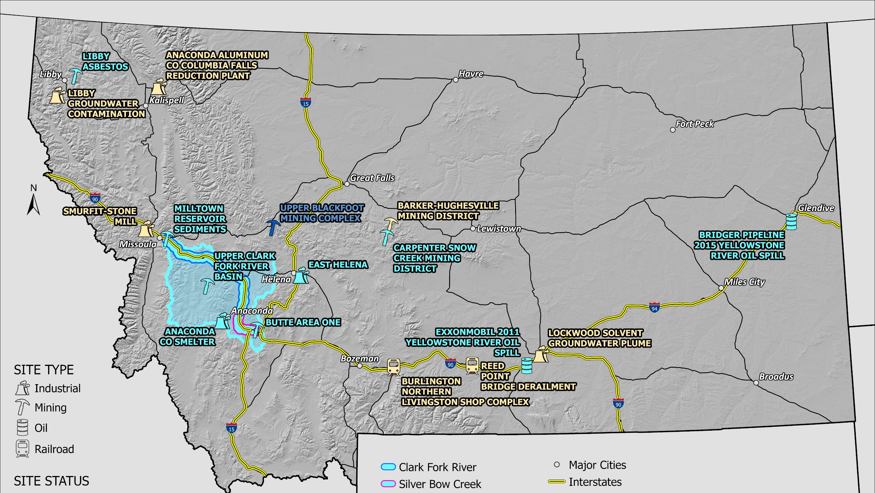

Slide 5
NRDP Recoveries for the State of Montana
Year | Area | NRD Recovered for Restoration ($millions)
1999 | Upper Clark Fork Basin – I | $144 (incl. $2 land)
2005 | Milltown Dam and Sediment Removal | $13 (cash and other value)
2008 | Upper Clark Fork Basin – II | $72.5
2009 | Upper Blackfoot River/Mike Horse Dam | $8
2009 | East Helena | $5 (plus 232 acres open space)
2016 | 2011 Yellowstone River ExxonMobil Oil Spill | $9.5 (plus $2.5 to US)
2020 | Butte CD | $20.5 total State settlement, with leftovers from Blacktail Creek remedy (DEQ) going to restoration.
2021 | Bridger 2015 Yellowstone River Oil Spill | $2.0 (to both State and US)
2023 | Libby OU3 | $18.5
Total |  | Over $293

Slide 6
HB2 NEW CLAIMS FUNDING FY24/25
New Claims Site (see Slide 5) | NRDP Expenses | Reimbursed Funds
Barker-Hughesville | $562 | $0
MT Tunnels Bankruptcy | $1,107 | $0
Whitaker Clark & Daniels Bankruptcy (Lockwood) | $38,593 | $0
Reed Point Bridge Derailment | $201,158 | $153,208
New Sites | $10,293 | $0
Smurfit-Stone Mill Frenchtown | $94,829 | $0
Anaconda Aluminum/Columbia Falls | $148,331 | $0
Burlington Northern Livingston Complex (BNLV) | $52,983 | $15,701
Libby Groundwater | $6,972 | $0
Total | $554,828 | $168,909
Updated through 12/18/2024

Slide 7
June 24, 2023
Twin Bridges Road railroad bridge collapsed, and Montana Rail Link (MRL) train cars derailed near Reed Point, Montana.
17 cars derailed, 10 entered the Yellowstone River, spilling contents into the Yellowstone River:
420,000 pounds asphalt (petroleum) released (6 cars)
~236,000 pounds recovered
~184,000 pounds remains in Yellowstone River
Reed Point Bridge Derailment

Slide 8
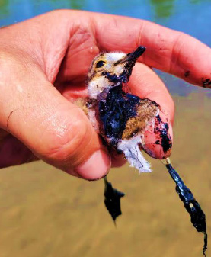
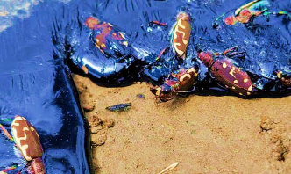
Reed Point (2023 Yellowstone R. Asphalt Spill)
Recreational & Ecological Injuries to Natural Resources & Services | Use of HB2 (New Claims) Funding
Riparian/aquatic injury (both asphalt cleaned up and remaining in Yellowstone River) Cleanup injuries Lost recreational use (Yellowstone & Stillwater Rivers) Diminished experience on the Yellowstone River due to remaining asphalt | Site visits & data Evaluate potential impacts to natural resources Coordinate with DEQ, FWP, and others Public outreach Assessment Work Plan Quantify and estimate injuries and damages Settlement negotiations

Slide 9
NRDP New Claims Budget
2023 Session House Bill 2 NRDP Funding (FY24 & 25)
Allocation | $1M
Expended to Date | $555K
Estimated Expenses through FY25 | $195K
Estimated Total Expenses | $750K
Estimated Potential Return to General Fund | $250K
2025 Session House Bill 2 NRDP Funding Request (FY26 & 27)
Request | $1M
Estimated Net Request (w/ potential 2023 return) | $750K

Slide 10
Natural Resource Damage Program
Doug Martin, Administrator
(406) 465-1131
dougmartin@mt.gov
Natural Resource Damage Program
(406) 444-0205
dojnrdp@mt.gov

