Slide 1
State Attorney’s Office (SAO)
January 2025
Section D Budget Presentation

Slide 2
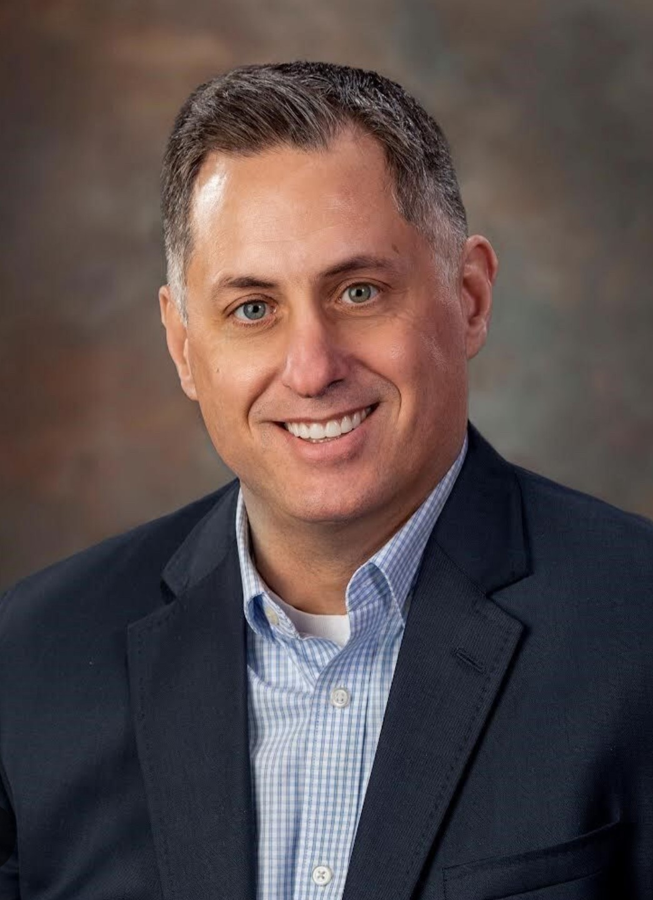
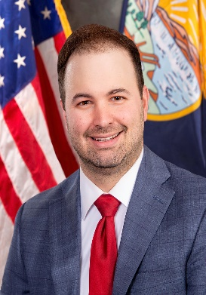
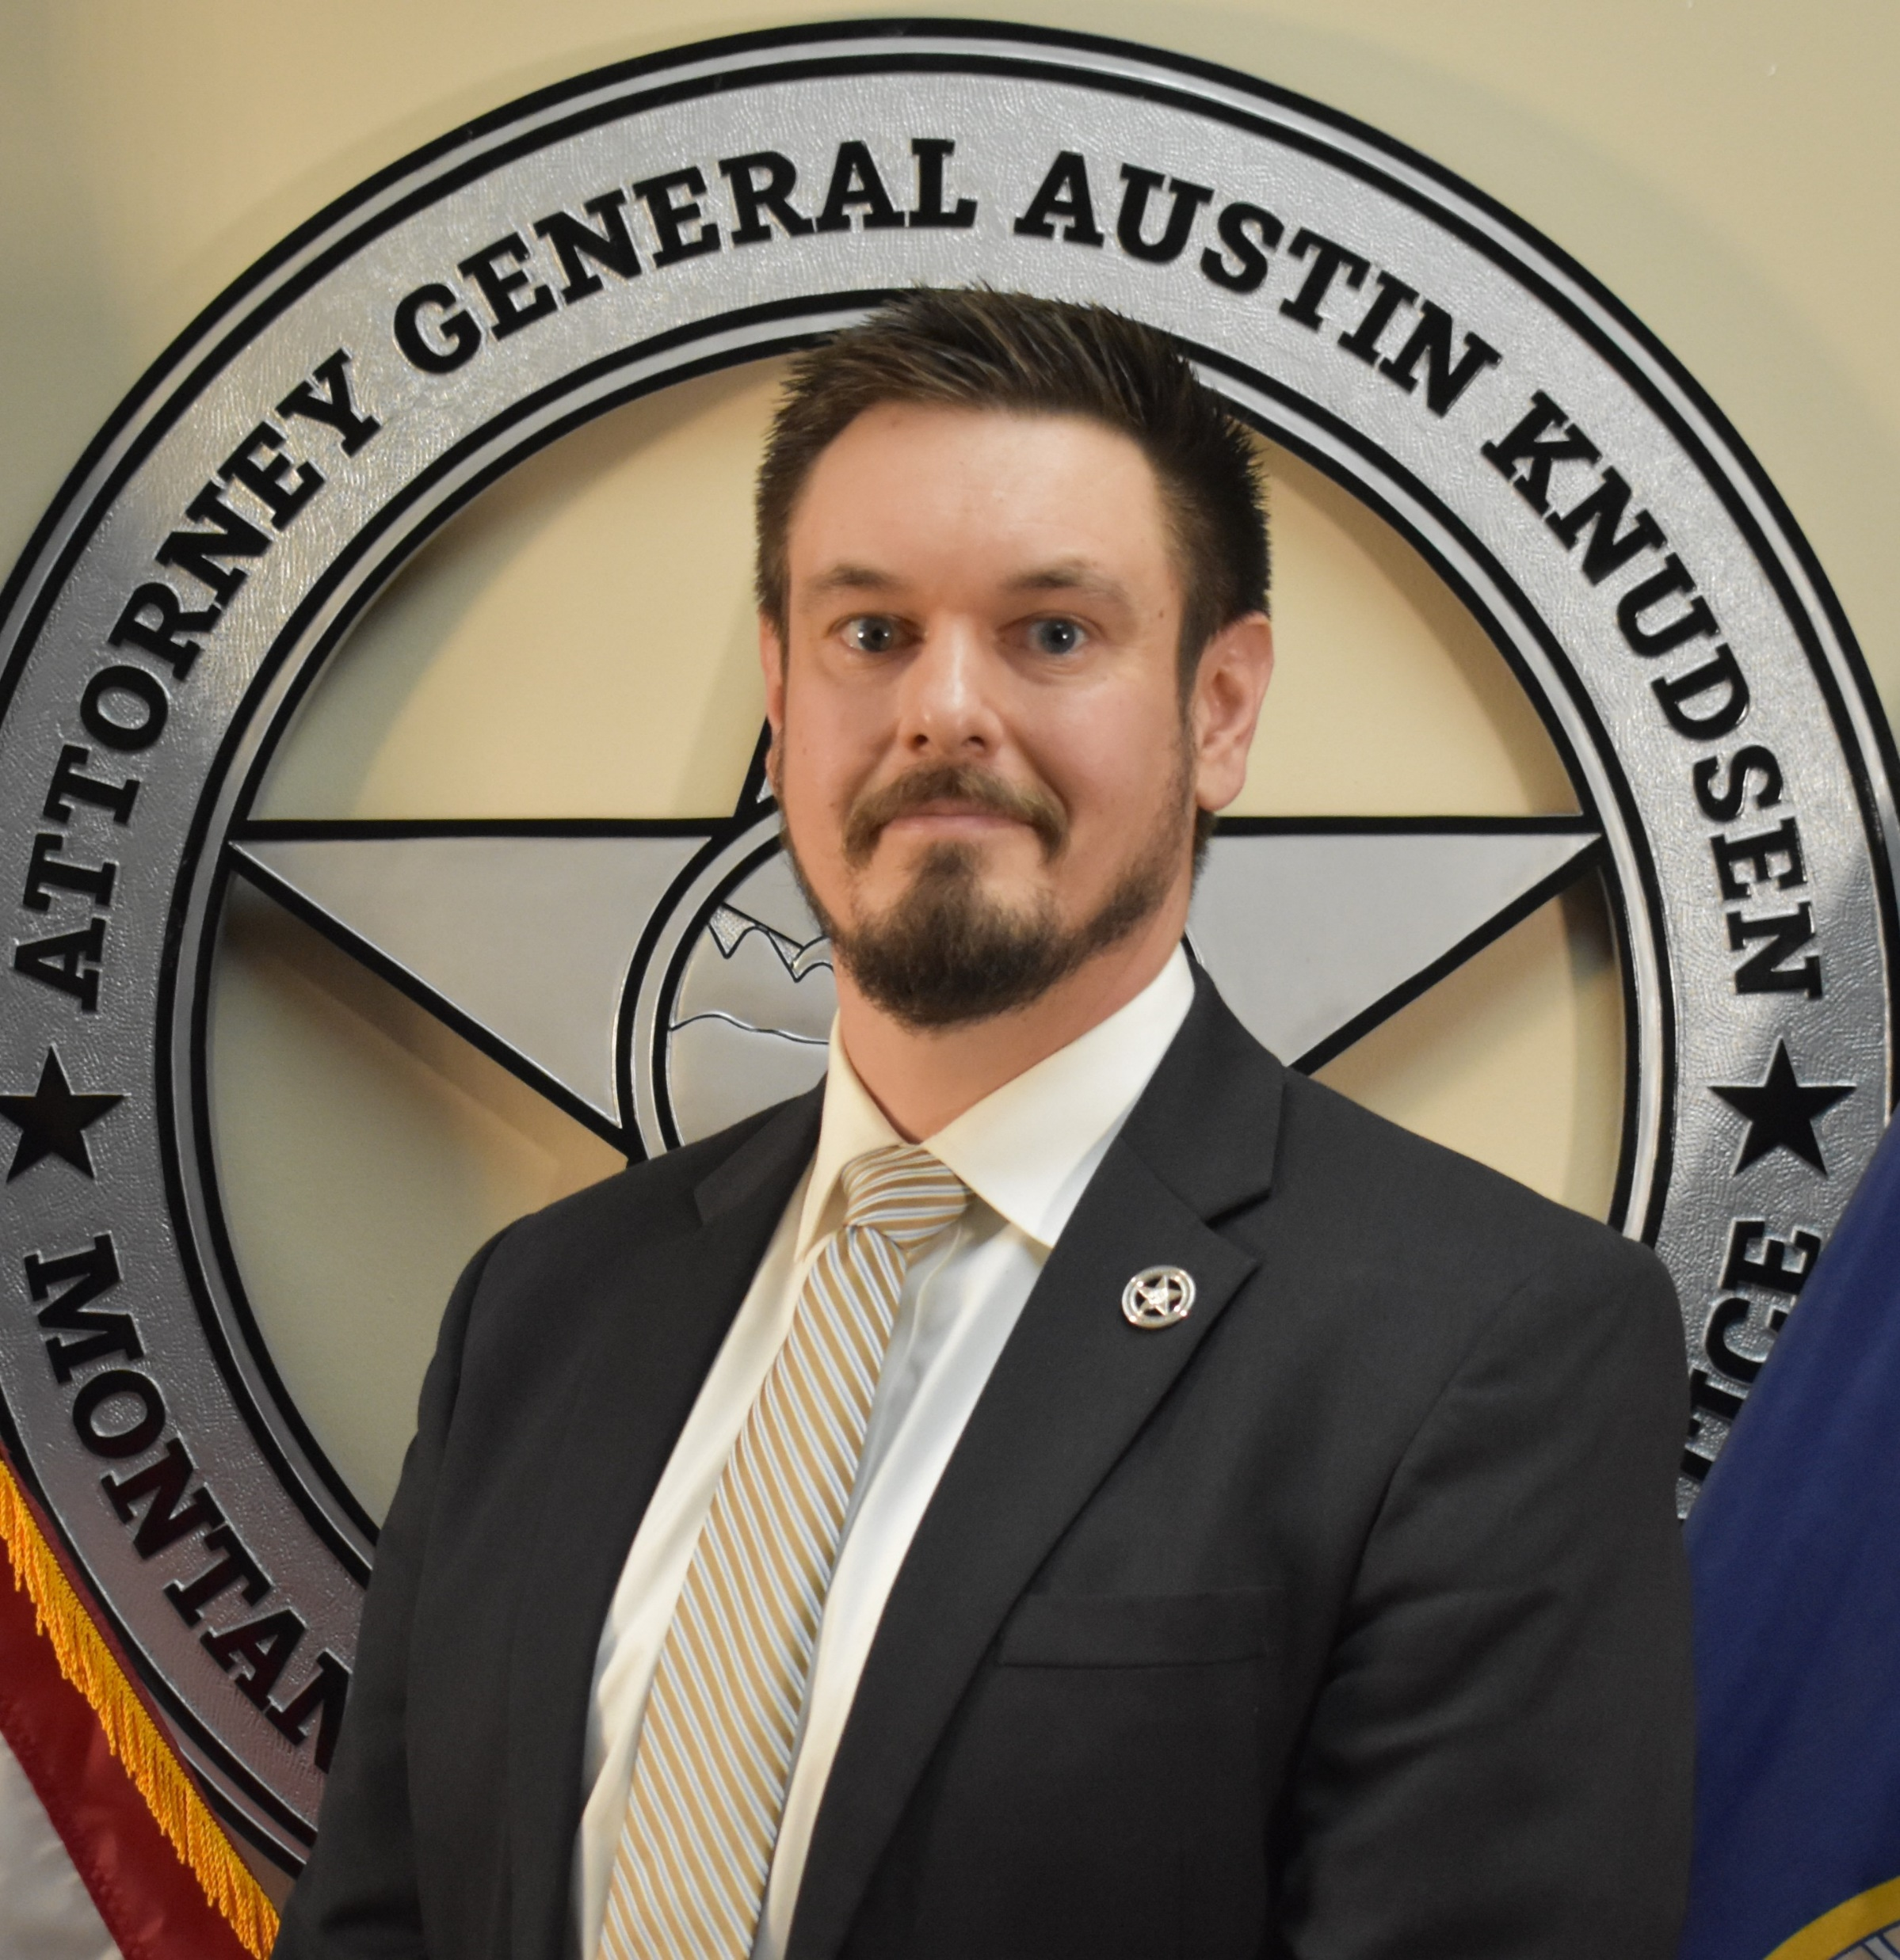
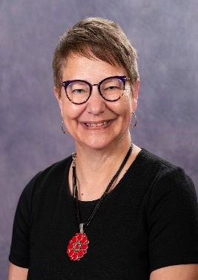
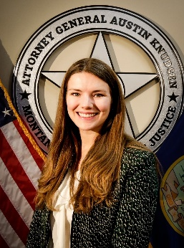
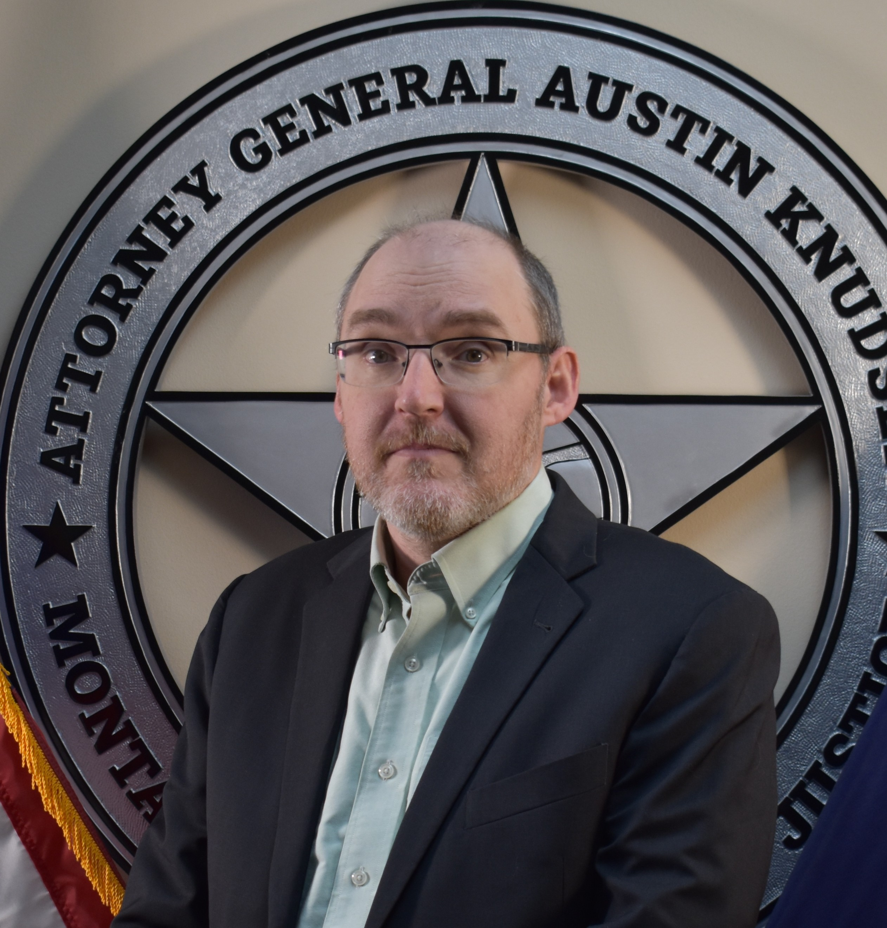
State Attorney Office Org. Chart
Administrator
Natural Resource
Damage Program
Appellate Bureau
Tammy Plubell
Office of Consumer Protection
Brent Mead
Agency Legal Services
Aislinn Brown
Civil Bureau
Mike Russell
Child Protection Unit
Karen Kane
Prosecution Services Bureau
Dan Guzynski
Solicitor General
Christian Corrigan

Slide 3
State Attorney Office Org. Chart
Administrator
Agency Legal Services
Appellate Services
Office of Consumer Protection
Criminal Appeals
Constitutional Challenges
Multistate Litigations
Tobacco Litigation
Charities & Non-Profits
Civil Services
Dependent Neglect / Youth in Need of Care Appeals
Federal Habeas
Capital Committee
Water Abandonment cases
Prosecution Services
Special Prosecutors: FWP; State Fund; TSRP, DOC
State Appeals Committee
State Habeas
Child Protection Unit
NRDP
Solicitor General
FTE Information
61 Total FTE
12 Modified Grant/MOU

Slide 4
State Attorney’s Office Locations
Helena (HQ)
Civil Bureau
Appellate Bureau
Office of Consumer Protection
Agency Legal Services
Natural Resource Damages (administratively attached)
Prosecution Services
Missoula
Child Protection Unit
Prosecution Services
Bozeman
Appellate Bureau
Prosecution Services
Billings
Child Protection Unit

Slide 5
Items of Interest
The State Attorney’s Office operates as the in-house law firm for the State of Montana
Primary duties/obligations
Defend the constitutionality of State laws
Represent the State on all criminal appeals
Prosecute serious felonies at request of County Attorneys
Consumer Protection
Provide advice and legal services to State agencies

Slide 6
Agency Legal Services
Provides legal counsel to state government officials and state agencies.
Served 50 agencies in 2023 and 52 agencies in 2024.
Represents other state agencies in civil actions ranging from liability lawsuits to personnel issues.
ALS has an average caseload of 260 active cases
In the past year, ALSB has obtained numerous favorable results for its agency clients in state and federal courts. Its attorneys have experience in and provide advice for a broad variety of subject matters government agencies in Montana face.

Slide 7
Appellate Bureau
Represent the State on all criminal related appeals
Montana Supreme Court
Federal court
Ninth Circuit Court of Appeals
Provide statewide training to prosecutors and judges
10 Attorney FTE’s
3 Paralegal FTE’s

Slide 8
Appellate Services Significant Cases
CASES WITH SIGNIFICANT LEGAL ISSUES
Henderson v. State, 2024 MT 253
Held: The district court did not err when it denied Henderson’s motion for a new trial because the inconsistent statements made by the victim after the trial did not demonstrate that Henderson did not engage in the criminal conduct at issue. The Court overruled prior cases and clarified that Mont. Code Ann. § 46-21-102(2) cannot be used to obtain a new trial and will not result in reversal of a conviction unless the defendant has new evidence demonstrating his innocence.
Garding v. Montana Department of Corrections, 105 F.4th 1247 (9th Cir. 2024)
Held: The Ninth Circuit Court of Appeals reversed the federal district court’s order granting Garding federal habeas relief. The Court held that Garding’s lawyer had not ineffectively represented her by failing to obtain a crash reconstruction expert for trial because such expert is not necessary for effective representation and counsel performed effectively in other ways. Garding’s conviction for vehicular homicide was reinstated and she was placed back on supervision based on this ruling.

Slide 9
Appellate Services Significant Cases
CASES WITH SIGNIFICANT LEGAL ISSUES (cont’d)
State v. Hardy, 2023 MT 110
Held: The district court did not err in admitting testimony from inmates about information they learned from Hardy after they met with law enforcement because the inmates did not become government agents. Significant to that conclusion was the fact that law enforcement did not ask the inmates to obtain information or offer them anything in return for their information.
Held: The jury was fully and fairly instructed when the district court provided the pattern jury instruction on credibility. Hardy was not entitled to an instruction telling the jury to “carefully scrutinize the testimony” of the inmates.
Held: The Court declined to decide whether the district court erred when it prohibited the defense from commenting on the State’s failure to bring a witness to testify because the ruling was harmless when the defendant was able to elicit similar information and argue that the State had not met its burden to prove that he solicited an inmate to kill a witness.
Held: Hardy failed to demonstrate that the prosecutor engaged in misconduct that required reversal of Hardy’s convictions.

Slide 10
Appellate Services Significant Cases
CASES DEMONSTRATING NEED FOR LEGISLATIVE INTERVENTION
State v. Risher, 2024 MT 309
Held: Risher was entitled to credit for time served in the underlying case after a warrant was issued even though he was incarcerated on a different case and the warrant issued in this case was not served on him.
State v. Wolfblack, 2024 MT 166
Held: The sentence imposed upon revocation of a theft conviction had to run concurrently to any other sentence because when the original theft sentence was imposed, Wolfblack did not have any other convictions, so there was no other sentence for the theft sentence to run consecutively to. The Court reached this conclusion even though Wolfblack was convicted of sexual intercourse without consent after he committed theft and his sexual intercourse without consent sentence was ordered to run consecutively to his theft conviction.

Slide 11
Civil Bureau
Defend the constitutionality of State laws
Receive service of process for the State, its agencies, and officers
Liaison to Risk Management Tort Division re: tort claims against the State
Provide Attorney General opinions when properly requested
Review ballot measures for legal sufficiency
Provide a variety of other legal services

Slide 12
CASES PENDING IN CIVIL BUREAU
Civil Bureau litigated more than 30 challenges to legislation in the last biennium alone, in addition to numerous other legal issues
Bills challenged:
2019: HB 694
2021: HB 136, HB 140, HB 171, HB 379, HB 407, HB 702, SB 99, SB 169, SB 199, SB 280, SB 319
2023: HB 359, HB 393, HB 544, HB 562, HB 575, HB 721, HB 862, HB 892, HB 937, SB 93, SB 99, SB 109, SB 202, SB 245, SB 323, SB 382, SB 458, SB 528
Definitions of “sex,” “male,” and “female;” “Gender-affirming care;” “sexually oriented performances” in presence of minors; “drag story hours”
Abortion: ultrasound offer requirements; viability determination requirements; 20-week ban;medication abortion risk protocol; D&E abortion prohibition; Medicaid coverage for abortions; abortion clinic regulations; parental consent statute for minor abortions (SCOTUS Cert. Petition forthcoming)
Challenges to legislative immunity
Challenges to the 2011 and 2023 MEPA amendments and the State’s energy policy
PSC redistricting: new map drawn by the Legislature
Public records litigation
School choice and funding

Slide 13
Wrongful Conviction Compensation Case
Marble v. State of Montana & Missoula County, DV 21-1209
Marble filed a claim for compensation for a wrongful conviction under §§ 46-32-101 et. seq. seeking $733,006.
The State and Missoula County jointly defended Marble’s claim in a 7-day trial in May 2024.
A Missoula jury found 10-2 that Cody Marble did not prove by a preponderance of the evidence that he did not commit the offense of Sexual Intercourse Without Consent, for which he was convicted resulting in a denial of his claim for compensation.
The Department of Justice has to seek additional HB 3 funding to recover its costs of defending the claim.

Slide 14
Child Protection Unit
The CPU is a team of experienced child abuse prosecutors who assist county attorney’s offices by providing training and handling the prosecution of civil Dependency Neglect cases at the request of county attorneys, when there is a conflict of interest, or when the CA is otherwise unable to represent the State.
The CPU has offices in Billings, Helena, and Missoula and focuses on ensuring the best practice prosecution and resolution of child welfare cases in MT.
CPU typically assists more than 30 County Attorney’s offices in every region of the State with more than 200 active Dependency and Neglect cases at any given time.

Slide 15
Child Protection Unit Significant Cases
CPU handled a complex Flathead County DN case involving abuse and neglect based on parental mental illness, substance use disorder, conduct leading to arrest and incarceration, and violent behavior factors. Mother of child arrested in Flathead County during DN case and charged with felony Intimidation for alleged threats to harm local child protection specialists. The bench trial was held in July 2024 and the State called approximately 40 witnesses over 6 days, resulting in termination of parental rights.
CPU assisted Park County Attorney’s office with a complex DN case involving significant non-accidental trauma to an infant that caused a fractured tibia and multiple fractured ribs in different healing stages. A multi-day bench trial was held and the State called medical professionals that treated the child at a Bozeman hospital as well as an expert medical witness that testified regarding the non-accidental / abusive nature of the child’s injuries, resulting in termination of parental rights.

Slide 16
Child Protection Unit Significant Cases
CPU is handling a complex DN case in Deer Lodge County involving a mother who gave birth while committed to the Montana State Hospital. Mother identified a putative father of the child as a man who may be a member of a federally recognized Indian tribe, but whose paternity was not conclusively established. CPU is ensuring that the Department of Family Services makes required efforts to resolve issues of paternity to allow the identified tribe to determine whether the baby is a member, or is eligible for membership and the biological child of a member, to ensure compliance with the Indian Child Welfare Act.

Slide 17
Prosecution Services Bureau
Composed of 11 Prosecutors and 3 paralegals.
Upon request of Montana County Attorneys, PSB prosecutes various complex criminal cases, such as homicides and child sexual abuse cases.
Most of PSB’s cases take place in rural Montana
PSB has specialized prosecutors assigned to FWP, DOC, MT State Fund, and a Traffic Safety Resource Prosecutor.

Slide 18
Murder of Deputy Mason Moore
PROSECUTED BY PSB AND BROADWATER COUNTY

Slide 19
State v. Lloyd Barrus
Lloyd Barrus was charged with deliberate homicide after killing Deputy Mason Moore.
Barrus and his son shot and killed Deputy Mason Moore, firing over 20 shots into his vehicle, followed by a high-speed chase and shootout that began outside of Butte and ended East of Missoula.
Prosecution took place over 5 years- hundreds of hours spent on pretrial preparation and litigation.
Over 800 exhibits were admitted by the State.
24 witnesses called by the State to testify.
After a 2-week trial the Defendant was convicted of Deliberate Homicide for the death of Deputy Mason Moore and Attempted Homicide for shooting at law enforcement during the high-speed chase.
Jurisdiction: Broadwater County.
Investigated by: MT Department of Justice-Division of Criminal Investigation Bureau (DCI) and Missoula County Sheriff’s Office.
Prosecuted by: Prosecution Services Bureau and the Broadwater County Attorney’s Office.

Slide 20
State v. Lloyd Barrus (cont.)
A Butte-Silver Bow County jury of twelve CONVICTED Lloyd Barrus of deliberate homicide on Tuesday, September 21, 2021, after 2 hours of deliberations.
At the conclusion of 5 years of litigation and a two-week jury trial, Judge Kathy Seeley SENTENCED Lloyd Barrus in April of 2022 to 3 life sentences without the possibility of parole at Montana State Prison.

Slide 21
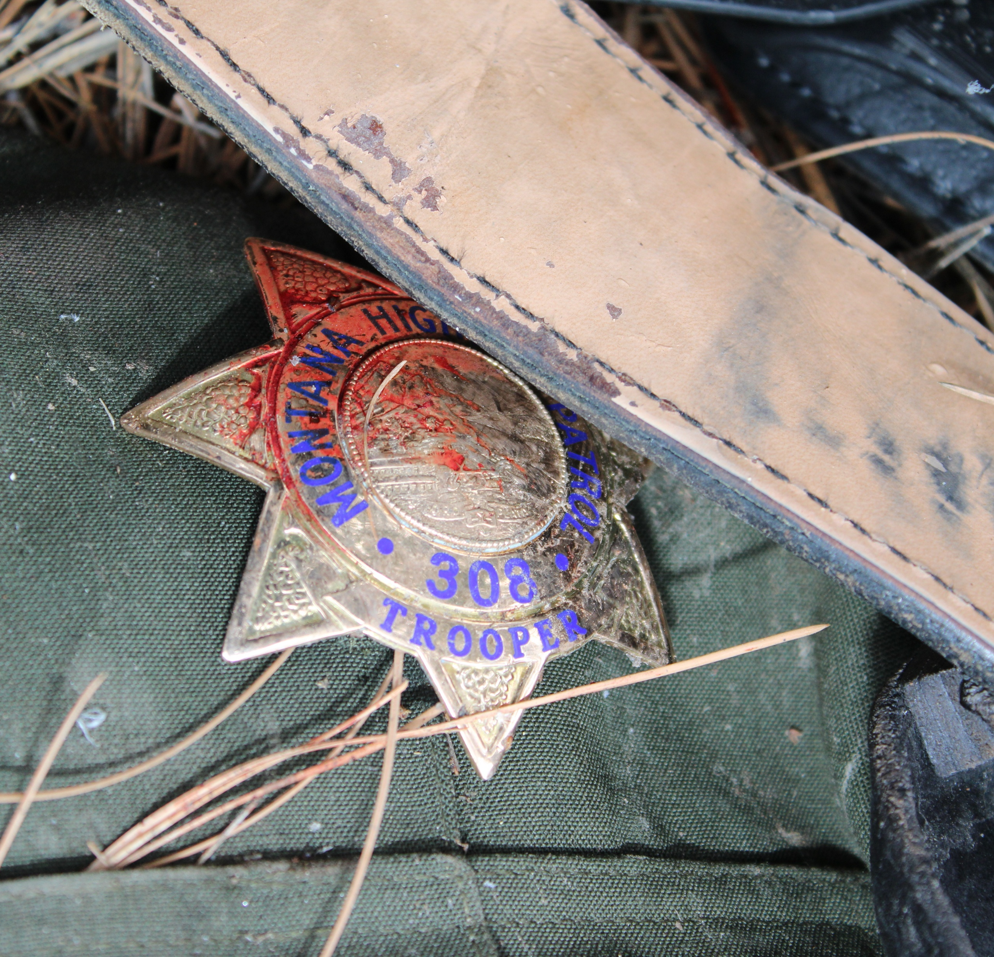
STATE vs. JASON MILLER

Slide 22
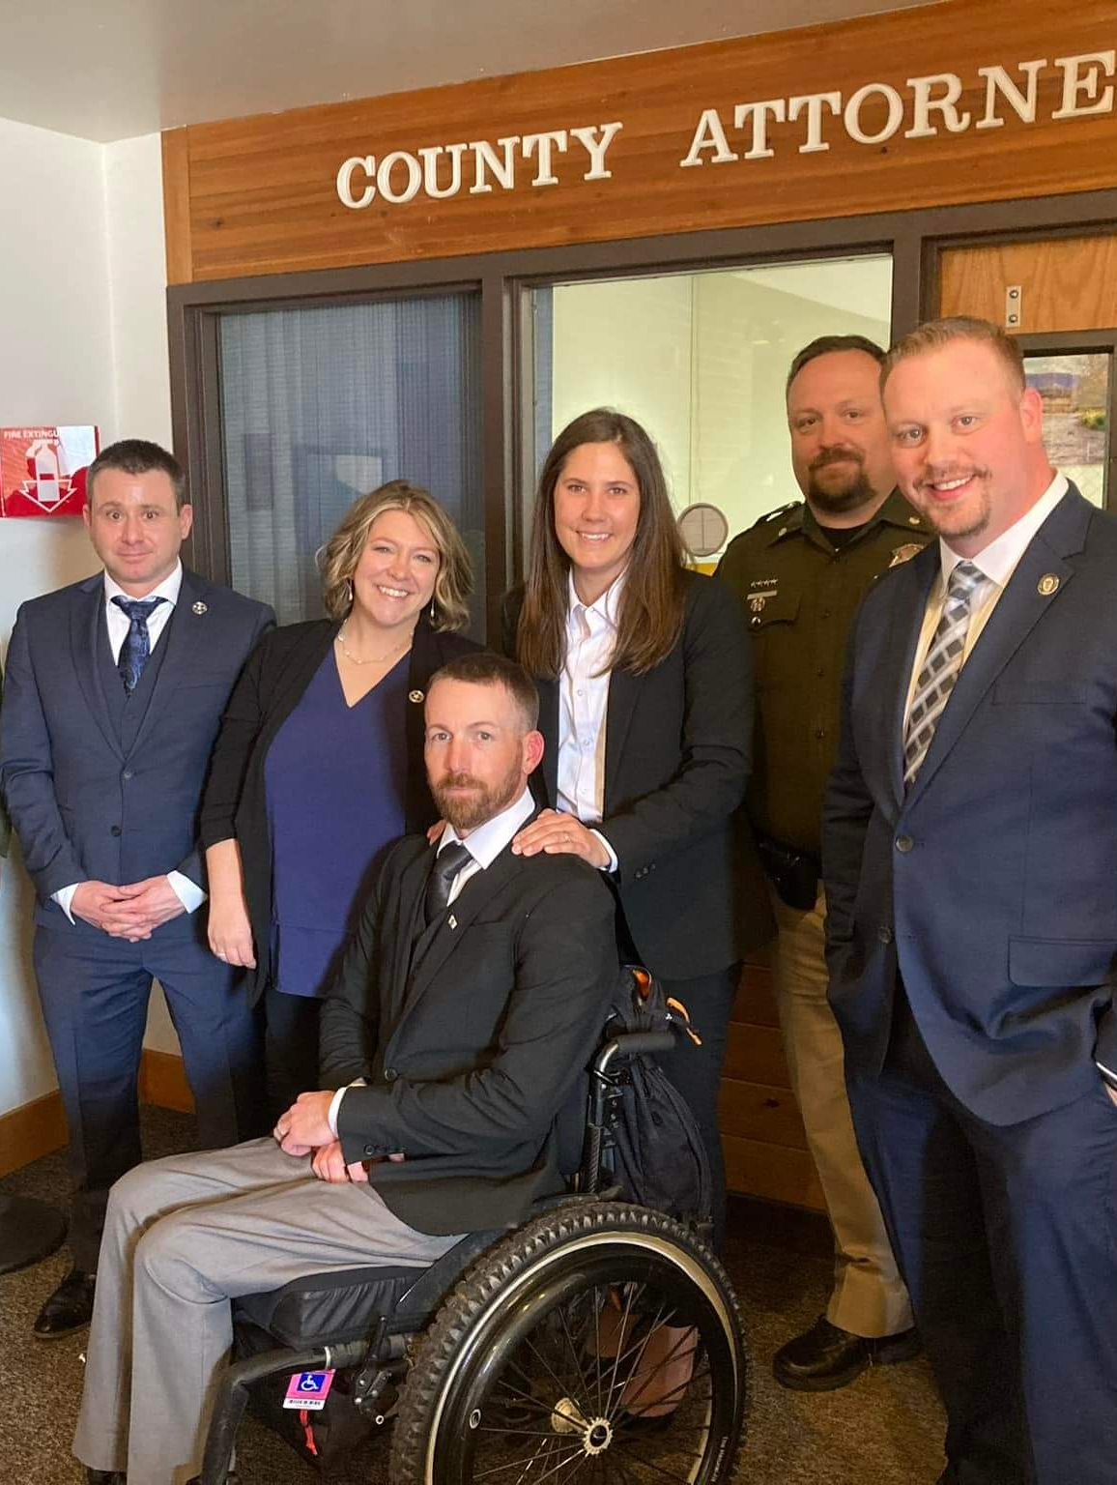
STATE V. MILLER
Dates: April 16, 2024 – April 19, 2024
State: Thorin Geist, PSB
Selene Koepke, PSB
Defense: Daniel Wood, OPD
Ryan Hennen, OPD
Charges: Count I – Att. Deliberate Homicide
Count II – Crim. Endangerment
Count III – Crim. Mischief
Count IV – CPDD
Count V – Agg. Kidnapping
(Designated as PFO)
Verdict: Guilty all counts.
Notes:
The case was investigated by DCI Agents Kevin McCarvel and Ryan Eamon, with assistance from the FCSO and the MHP. The Lincoln County Attorney’s Office charged Miller with Att. Deliberate Homicide, Criminal Endangerment, Criminal Mischief, Criminal Possession of Dangerous Drugs, and Aggravated Kidnapping. The DOJ offered assistance and the case proceeded to trial on April 16, 2024. On April 19, 2024, the jury returned a verdict of guilty on all charges.

Slide 23
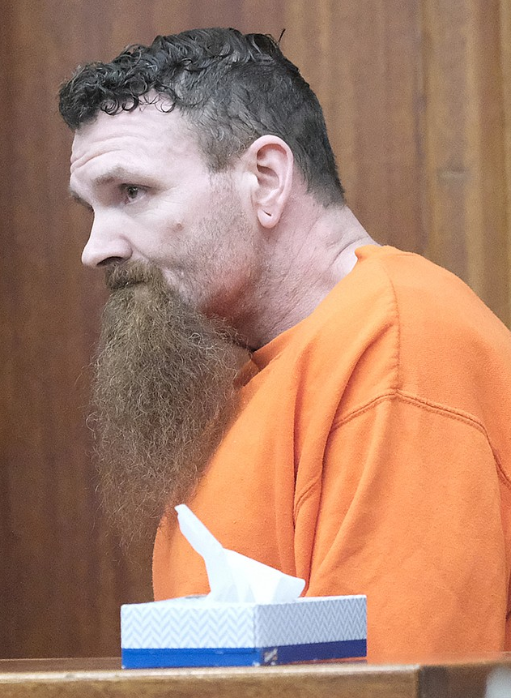
Sentencing
Count I – Attempted Deliberate Homicide:
Committed to the Montana State Prison for life, with none of that time suspended.
Ineligible for parole.
Consecutive to Counts II-V.
$75,000 in restitution to Trooper Johnson.
$1.21 million in restitution to State of Montana (Workers’ Compensation & Crime Victim Compensation)

Slide 24
Sentencing Cont.
Count II – Criminal Endangerment:
Committed to the Montana State Prison for 15 years, as a PFO, with none of that time suspended.
Consecutive to Count I, but concurrent with Counts III-V.
Count III – Criminal Mischief:
Committed to the Montana State Prison for 15 years, as a PFO, with none of that time suspended.
Consecutive to Count I, but concurrent with Counts II, IV-V.
$22,430 in restitution to State.

Slide 25
Sentencing Cont.
Count IV – CPDD:
Committed to the Montana State Prison for 5 years, as a PFO, with none of that time suspended.
Consecutive to Count I, but concurrent with Counts II-III, V.
Count V – Aggravated Kidnapping:
Committed to the Montana State Prison for 15 years, as a PFO, with none of that time suspended.
Consecutive to Count I, but concurrent with Counts II-IV.

Slide 26
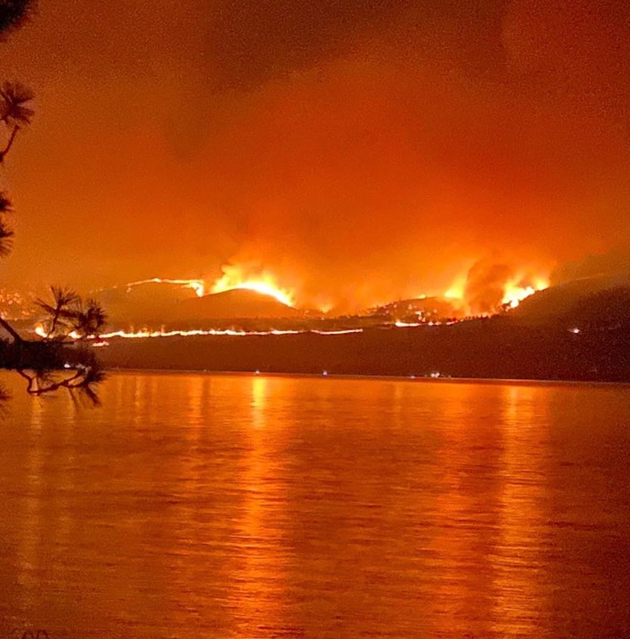
STATE vs. CRAIG McCREA
Notes:
In 2021 Montana’s northwest region was inundated with a series of forest fires. The largest of which was the Boulder 2700 fire, and it devastated the eastside of Flathead Lake.

Slide 27
Craig Allen McCrea
Charges: (4) Counts of Arson, felonies in violation of § 45-6-103, MCA.
History: 2015 Burglary
2015 CPDD
2022 CPDD
2023 Possession with Intent to Distribute Fentanyl
Notes:
Det. Yonkin identified Craig Allen McCrea as the suspect. Mr. McCrea had a long history of drug use. Aside from distribution, his only source of income was his father, Bob McCrea, the Chief Wildland Firefighter for the Confederated Salish & Kootenai Tribe. Without fires, Bob McCrea had no money to give his son, and without money Craig McCrea couldn’t afford his drug habit.

Slide 28
Trial
Dates: Feb. 2, 2024 – Feb. 8, 2024
State : Thorin Geist, PSB
Caitlin Creighton, PSB
James Lapotka, LCAO
Defense: Shandor Badaruddin
Charges: (4) Counts of Arson, designated as a PFO.
Verdict: Guilty (2) Counts of Arson, including Boulder 2700 Fire.

Slide 29
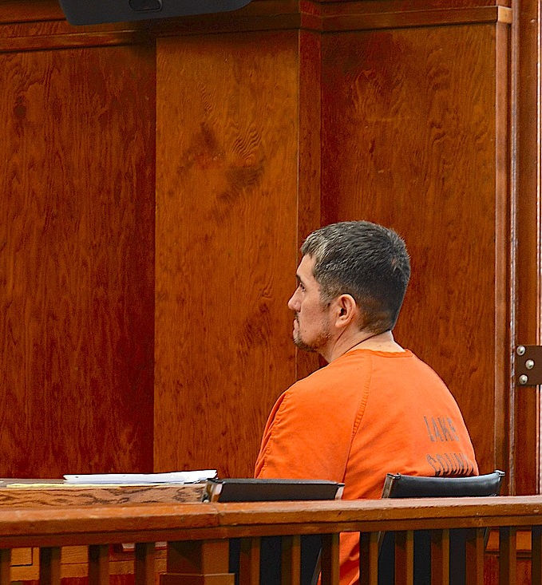
Sentencing
Count III - Boulder 2700 Fire:
Committed the Montana State Prison as a Persistent Felony Offender for 60 years, with 30 of those years suspended.
15-year Parole Restriction
Ordered to pay $1.9 million in restitution.
Concurrent to Count IV.

Slide 30
Sentencing Cont.
Count IV – Finley Fire:
Committed the Montana State Prison as a PFO for 60 years, with 30 of those years suspended.
15-year Parole Restriction.
Concurrent to Count III.

Slide 31
Office of Consumer Protection
Responds to and enforces Montana’s consumer protection laws & regulations relating to unfair and deceptive business practices
Notes:
Montana Office of Consumer Protection and Victim Services:
As required by Articles II, XII and XIII of the Montana Constitution, the Office of Consumer Protection and Victim Services fulfills a broad mission for the protection and education of Montanans against unfair and harmful practices of businesses, individuals and associations; protection of the rights of victims of crime; enforcement of tobacco laws and the Master Settlement Agreement; and oversight of nonprofits, charitable trusts and foundations as required by various statutes, including the Crime Victims Compensation Act, the Tobacco Product Reserve Fund Act, the Montana Nonprofit Corporation Act, the Uniform Prudential Management of Institutional Funds Act, the Montana Uniform Trust Code, and the Montana Unfair Trade Practices and Consumer Protection Act.

Slide 32
Opioid Litigation
Settled with Opioid Pharmacies, with Funds from the Settlement going to the Montana Opioid Abatement Trust.
Montana Opioid Abatement Trust Created to Provide 62 Subdivisions with funds to combat the opioid crisis.
A settlement has been reached with Kroger Pharmacies and is in the final steps of the settlement process.

Slide 33
Social Media Platforms Litigation Unfair Trade Practices
Montana filed suit against Meta Platforms, Facebook and Instagram, in State Court for their harms to children.
Claims include misrepresenting the appropriate age rating for the app and the inappropriate content available to children.
Montana filed suit against TikTok, including their parent company Bytedance in State Court.
Claims include misrepresenting the appropriate age rating for the app and the inappropriate content available to children.
The purposefully designed addictiveness of the app.

Slide 34
Asset Manager Litigation Antitrust
Montana along with 10 sister-states filed suit against Blackrock Inc., State Street Corporation, and The Vanguard Group, Inc. in the E. District of Texas.
Defendants are three of the largest institutional investors in the world.
Claims focus on the coal industry, namely Powder River Basin Coal.
Claims include violation of Section 7 of the Clayton Act, prohibiting any acquisition of stock where “the effect of such acquisition may be substantially to lessen competition.” 15 U.S.C. § 18.
The defendant's stockholdings in publicly held coal producers have lessened the competition of the coal market.

Slide 35
Generic Drugs Antitrust Litigation
Lawsuits stem from a massive investigation in the U.S. generic drugs market.
Possibly the largest domestic corporate cartel case in U.S. history.
Allegations include an overarching conspiracy to fix prices and allocate markets.
Combined, the lawsuits focus on over 200 drugs, prescribed for treatment in a range of diseases and conditions.
The Defendants include over two-dozen corporate defendants and over two-dozen individuals.

Slide 36
State Attorney’s Office Budget Fiscal Year 2025

Slide 37
Budget Requests
Notes:
DP 1 - Personal Services - The executive requests adjustments to the present law personal services budget. This request has been broken into the following categories, and further detail is shown in the agency summary: • Legislatively approved changes • Management decisions • Budget modifications made to the personal services budget in the 2023 biennium
DP 2 - Fixed Costs - The executive requests adjustments to provide the funding required in the proposed budget for fixed costs assessed by other agencies within state government for the services they provide. Examples include: warrant writer, motor pool, information technology services, etc. The rates charged for these services are approved in the section of the budget that provides the services.
DP 3 - Inflation Deflation - The executive requests adjustments to reflect budgetary changes generated from the application of inflation and deflation factors to specific expenditure accounts. Affected accounts include: other services, supplies and materials, communications, in-state motor pool and motor pool leased vehicles, and repair and maintenance.
DP 102 - Litigation Funding - RST/Bien - The executive requests an increase in general fund authority for litigation expenses. The funding will provide additional resources including experts, outside counsel, and increased costs in courts nationwide. The appropriation will also provide funding to pay for litigation expenses like discovery costs, technical support, trial preparation, and in some cases, attorney fees and costs the state must pay pursuant to court orders. Since 2021, the volume of constitutional challenges to state laws has increased significantly.

Slide 38
Budget Requests (cont.)
Notes:
DP 101 - Civil Attorney - The executive requests an increase in general fund authority for the addition of 3.00 FTE lawyers. These positions are intended to address the increased workload volume of constitutional challenges to state laws.
DP 197 - Appellate Attorney - The executive requests an increase of state special revenue authority for the addition of one appellate attorney within the Appellate Bureau. This request is contingent on passage of 2023 session legislation.
DP 198 - Natural Resource Damage Program Contingency - OTO/Bien/RST - The executive requests a one-time-only increase in general fund authority as contingent funding for the Natural Resource Damage Program (NRDP).
DP 199 - State Attorney's Office Prosecution Enhancement - The executive requests state special funding authority for the addition of 3.00 FTE lawyers to address the increased prosecutorial casework related to use of force, homicides, officer-involved shootings, and cold case requests. One FTE will be a dedicated prosecutor for human trafficking casework

Slide 39
State Attorney Office
Will Selph
SAO Administrator – Interim
Department of Justice
william.selph@mt.gov
Presenter: Tammy Plubell
Appellate Services Bureau Chief

