Slide 1
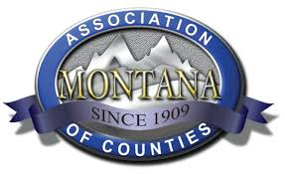
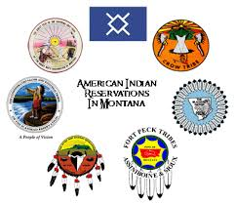
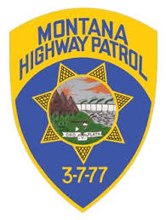
State of Montana Public Safety Communications system
April 23, 2025

Slide 2
2024 - Communications System Overview
Communication Sites
Supports “Trunking” and “Conventional” operation
Provides radio coverage for Public Safety users
78 Trunking sites, supporting 1116 Talkgroups
186 Legacy Conventional Channels
Dispatch Centers
17 Dispatch Centers with State Equipment
(Flathead County, Flathead Backup, Billings 911, Billings Co-Loc, Helena, Helena DS 6, Great Falls 911, MHP, Butte Silver Bow, Central Montana, Blaine County, Broadwater County, Hill County, Pondera, Wolf Point, Big Horn 911, Richland SO)
Upcoming: Glacier, Liberty, Daniels, and Valley Counties
Jefferson and Madison Counties with other vendor’s equipment
76 Dispatcher positions
Public Safety radio users
16,583 Radios
33,935 Trunking Calls Daily
46,765 Dispatch Call Daily
Radio Network “Cores”
Handles call processing and system management
Located in Helena and Billings
Statewide MPLS microwave and fiber network
132 MPLS routers located at 80 sites
Connects RF sites, Console sites, and the Cores to provide system resiliency

Slide 3
2024 - Radio System Users - 16,583 Total Radios

Slide 4
2024 - Top 40 Talkgroups

Slide 5
2024 - Trunking Call Count by Site

Slide 6
2024 - Trunking Call Count by Month – 12,386,331 Total

Slide 7
2024 - Trunking Call Count by Dispatch Site – 6,685,688 Total

Slide 8
2024 - Analog Conventional Call Count by Dispatch Site – 8,669,602 Total

Slide 9
2024 - Digital Conventional Call Count by Dispatch Site – 1,703,236 Total

