Slide 1
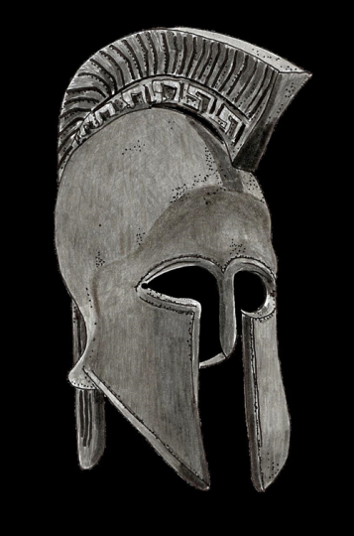
Surviving Violent Encounters:
Maximize Your Physiological and Psychological Responses
Oct 27-28, 2025/ 0800-1700 hours
Hosted by the Bozeman Police Dept and HIDTA
901 N Rouse Ave
Bozeman, MT 59715
To Register: Surviving Violent Encounters | Rocky Mountain HIDTA
This 16-hour seminar is designed to prepare law enforcement officers for violent encounters and threats. The instructors will discuss techniques that control stress responses so de-escalation strategies can be effectively applied. The seminar will not only deal with the latest research on how threats impact psychological and physiological responses but will explore ancient survival traditions and why these traditions are relevant today. Case studies with audio and video recordings will be used to illustrate principles.
At the end of this program, students will:
Understand and recognize the physiological and psychological changes that occur when a person is suddenly threatened.
Understand how these psychological and physiological changes affect performance and the ability to survive.
Understand how physical training, mental imagery, tactical self-talk, breathing and centering improve stress inoculation, startle recovery and the ability to apply de-escalation techniques.
Understand how experiencing a sudden stressful situation can lead to a “high”, Post Traumatic Stress Disorder (PTSD) and/or Post Traumatic Growth.
The instructors, Laura Russell and William Hladky, are retired Miami-Dade Police Officers with more than 65 years of combined experience. They bring a rare perspective to the class. Each instructor has been involved in deadly force encounters with armed attackers. Additionally, Detective Russell was shot while attempting to arrest a subject. These and other experiences give the instructors unparalleled credibility.
For more information on the course, including instructor bios, go to www.survivingviolentencounters.com
For Questions: Call or Text, LG Russell at 954-632-1106 or send an email through the website.
A warrior-mindset.com course

