Slide 1
911/988 Integration
9-1-1 and Public Safety Communications Joint Advisory Council Meeting
May 9, 2024

Slide 2
988 and Suicide Prevention

Slide 3
National Suicide Facts
In 2022 there were 49,449 suicides in the country:
Averaging 135 suicides per day or 1 suicide every 11 minutes
This translates to an annual suicide rate of 14.9 per 100,000
Suicide completion:
Men complete suicide at a rate four times that of women
Suicide attempts:
Women attempt suicide three times more often than men
Firearms remain the most commonly used method for completed suicides:
Nearly 53% of all completed suicides are by firearm
In 2023, 69% of suicides in Montana were by firearm
In 2023, 71% of youth suicides in Montana were by firearm (36% nationally)

Slide 4
Suicide in Montana
Montana has ranked in the top five states for suicide rates in the nation, for all age groups, for the past forty years
Montana has the 2nd highest rate of suicide in the United States:
According to the most recent numbers released by the National Vital Statistics Report for 2021, Montana had 354 suicides for a rate of 31.7
Preliminary numbers for 2022 show a drop to 326 for a rate of 29/100,000
Unofficial numbers for 2023 show a further drop to 304

Slide 5
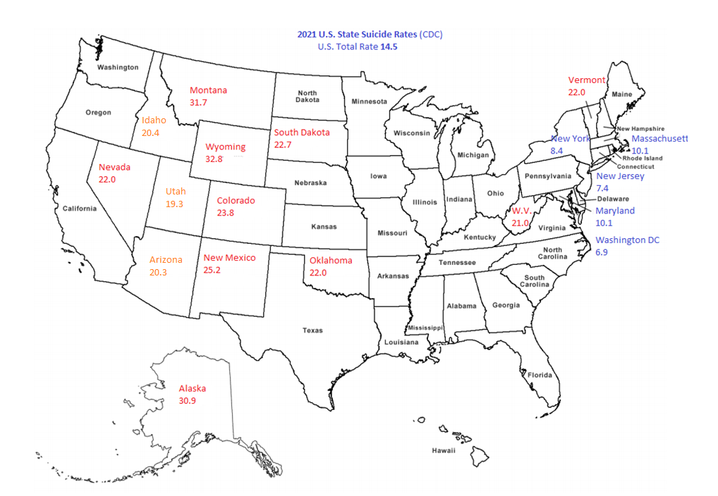
2021 U.S. State Suicide Rates (CDC)
National Rate: 14.5
Montana Rate: 31.7

Slide 6
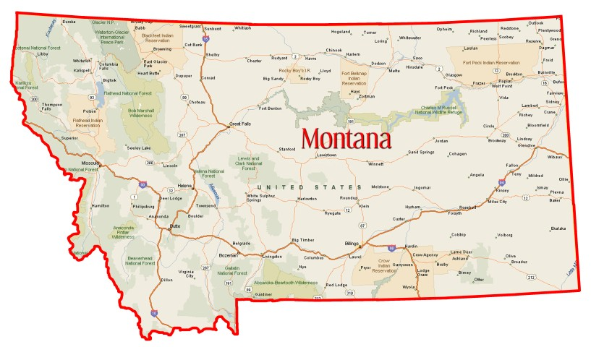
Contributions to MT’s High Suicide Rate
Vitamin D Deficiency (correlated with increased risk of depression)
High concentration of Veterans, American Indians, and middle age White men
Alcohol as a coping strategy
(alcohol in the blood at the time of death is 2x the national average)
Why does Montana have such a high rate of suicide?
It’s not one factor, but rather multiple factors all occurring at the same time
It is a cultural issue
Altitude
Metabolic stress caused by long- term oxygen deprivation. Worldwide, above 2,500 feet, you see a spike in suicides. The average suicide in Montana occurs at 3,500 feet
Access to Lethal Means
Nearly 65% of suicides are by firearm and nearly 90% of all firearm deaths in Montana are suicides
Social Isolation
Montana has 7.6 people per square mile. The national average is 94.
STIGMA
We see depression as a weakness, that we are a burden. And if you think you are a burden, how likely are you to ask for help?
Socioeconomic
1/5 Montana kids live more than 100% below the federal poverty level
Lack of Behavioral Health Services
Lack of psychiatrists and integrated behavioral health into primary care.

Slide 7
988 Operations

Slide 8
What is 988?
Operates with the objective of providing emotional support and connection to resources for people in crisis or emotional distress
988 is a three-digit, national hotline that is:
Answered by an accredited suicide and mental health crisis counselor
Free and confidential
Accessible 24/7, every day of the year
Stabilizes 80% of calls, requiring no additional, immediate interventions
Linked to 211:
The statewide referral database that tracks mental health providers and resources that are locally available

Slide 9
Montana Crisis Call Centers
Voice of Hope
Help Center 211
Lifeline Call Center
988
Local Number
211
988
Local Number
211
988

Slide 10
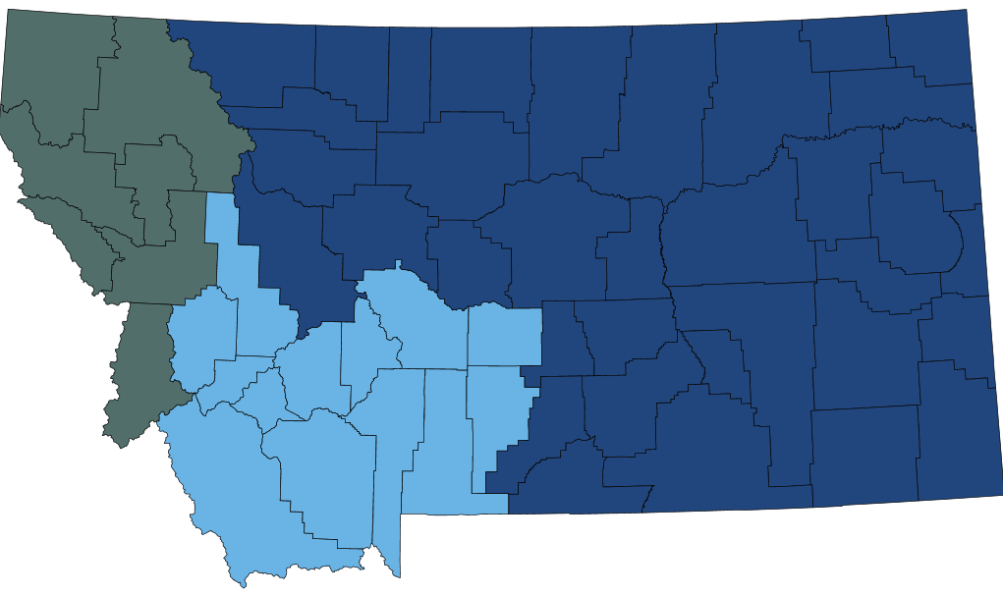
988 Coverage by Call Center

Slide 11
Crisis Now in MT

Slide 12
The Crisis Now Model
Someone to Call
Someone to Respond
Somewhere to Go
Essential Principles & Practices
988 Crisis Call Centers - Technology for real-time support and coordination.
Mobile Crisis Response Services - Mobile crisis offers outreach and support where people in crisis are.
Crisis Stabilization Programs - Short-term and community-based stabilization.
Data driven, best practices, recovery orientation, trauma-informed care, peers, and safety.

Slide 13
911/988 Integration

Slide 14
Integrating 911 and 988 Systems
Integration promotes awareness of 988 and its role in crisis response and will support an increase in appropriate use of 988
Formal agreements for integration would include:
Clear descriptions of the roles of 911 vs. 988
Guidance for 911 PSAPs on how they can effectively integrate 988 into their dispatch protocols, specifically around mobile crisis response services
Guidance for 911 PSAPs and 988 call centers on developing appropriate two-way call transfer protocols
Specific compliance and reporting standards around integration
Two-way data sharing capacity

Slide 15
Benefits to 911/988 Integration
Integration has the power to:
Free up 911 PSAPs by delegating the following to 988 call centers:
Dispatch of mobile crisis response programs
Call handling of calls from individuals experiencing a crisis that can be de-escalated over the phone without need for immediate dispatch of services
Support individuals experiencing crisis to:
Access appropriate services in a timely manner
Avoid more intensive interventions, lessoning strain on existing systems
Better leverage 988 to support first responders when they are in contact with individuals in crisis, especially when they are not trained in suicide intervention, or mental health crisis de-escalation

Slide 16
Local, State, and National Support
Local, state, and national initiatives are aimed at supporting integration of 911 and 988
Federal Level:
SAMHSA working with DOT, NASMHPD, and the National Association of State 911 Administrators to increase the number of states that have processes and protocols for 911/988 coordination
State Level:
DPHHS crisis team fostering local provider and 988 call center buy-in
The Governor’s Office facilitating collaboration between DPHHS and Montana DOJ on 911/988 integration:
Culminating in today’s presentation to begin dialogue on creating statewide processes and protocols for 911 PSAP coordination with 988 call centers
Call Center Level:
Some MOUs already exist with individual 911 PSAPs, but actions at Federal and State level should generate state guidance to 911 PSAPs to establish more MOUs with centers.
988 call centers are partnering with local coalitions and are beginning to reach out to discuss this with PSAPs in their area

Slide 17
Geographical Routing
Geo-routing is forecasted to be available as of late summer 2024, as cellular carriers expand the service to 988 calls
Geographical routing (geo-routing):
Is an algorithmic tool that routes phone calls from mobile devices to a set destination based on the geographical location of the caller and is relative to the nearest cellular tower
Capability is governed by cellular carriers
Is not the same as geo-location, which is a GPS-based capability to locate a caller to within 15 to 30 meters, based on tools only accessible to 911 Public Safety Answering Points (PSAP)
988 Call Centers do not currently have geo-routing capabilities:
Only mobile callers with 406 area codes can connect directly with Montana-based 988 call centers (Montana-based landlines are connected directly with local 988 call centers)
Mobile callers with out-of-state area codes are routed to call centers that cover their area code:
The answering 988 call center can transfer callers to their local Montana 988 call center, but this creates a delay in accessing appropriate care

Slide 18
Housekeeping FAQs
988 services are not interchangeable with 911:
911 responds to emergencies requiring LE, EMS and Fire, while 988 responds to mental health emergencies with trained crisis counselors
988 funding proposals will not reduce or pull from 911 budgets
Unlike 988, 911 does not have direct access to the 211-referral database
You may already be working with your local 988 call center as they already transfer calls to 911 when appropriate
988 is not a dispatcher of emergency response services such as law enforcement, fire, or EMS (still handled by 911), but informally deploys mobile crisis response programs when available and appropriate

Slide 19
Goals and Next Steps
Today’s Goals:
Increase general awareness of 988 and the benefits around 911/988 integration
Gather feedback from 911 PSAP representatives on integration plans
Next Steps:
Develop statewide guidance for integration through ongoing collaboration with 911 PSAP, 988 call center representatives, and other relevant stakeholders
Support local 911 PSAP and 988 call centers in entering into formalized integration agreements (MOUs/MOAs)

Slide 20
Q&A – Discussion Karl Rosston – krosston@mt.gov John Tabb – john.tabb@mt.gov Violet Bolstridge – violet.bolstridge@mt.gov

