Slide 1
Human Trafficking & Missing Persons
Dana Toole, LCSW
Montana Department of Justice
June 12, 2019
Helena, MT

Slide 2
WHAT IS TRAFFICKING
The recruitment, harboring, transportation, provision, or obtaining of:
a person for labor or services, through the use of force, fraud, or coercion for the purpose of subjection to involuntary servitude, peonage, debt bondage, or slavery.
Sex trafficking is a commercial sex act induced by force, fraud, or coercion,
Child Sex trafficking is the person induced to perform such acts that has not attained 18 years of age.

Slide 3
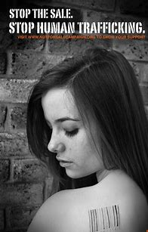
Humans as Commodity
One human being can be sold to another human being for sex thousands and thousands of times or exploited for labor for thousands of hours – annually for year after year.
Traffickers are business owners and both their products and their customers are people.

Slide 4
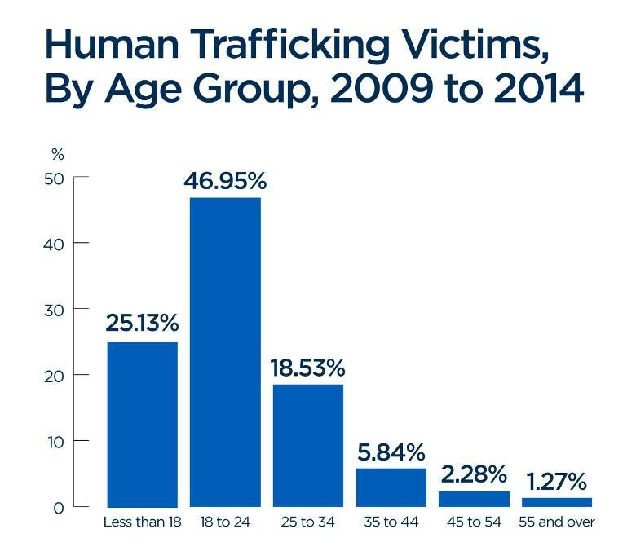
Types of Trafficking
Labor Trafficking
Sex Trafficking
Commercial Sexual Exploitation of Children

Slide 5
What is a Missing Person?
A person who has disappeared and it is unknown if they are still alive.
Types of missing:
Voluntary
Abducted/Kidnapped
Accident
Escape
Runaways
Lost/Injured
Disasters

Slide 6
Human Trafficking is a Multi-Billion Dollar Industry
Fastest growing illegal industry, second only to drug trafficking
High profits, low risk
Victims can be sold over and over again
A trafficker can make as much as $650,000/year sexually exploiting four children
An estimated 40.3 million people were victims of trafficking in 2016
1 in 4 victims are children
Women and girls are disproportionately affected
99% of commercial sex exploitation
58% in all other sectors
An estimated 200,000 children are sexually exploited in the US every year

Slide 7
Human Trafficking Does Not Discriminate
Anyone is vulnerable to being trafficking, regardless of age, gender, ethnicity, or economic status
There are, however, more vulnerable populations. Those most at risk include:
Runaways and Homeless Youth
Impoverished
Youth in Foster Care
A History of Trauma
Refugees and Undocumented Immigrants
Mental Health Challenges
Developmental Disabilities
Notes:
Traffickers prey on vulnerabilities such as better jobs/increased wages, a need for safety/protection or stability, love and attention.

Slide 8
Know the Signs
Grooming:
Love and support
Providing newest phones/games/clothing
Food and shelter
Better job or pay or education and training
Fear and threats
Drugs and addiction
Distance from home
Take identification/resources to get help
Missing:
Believe it will be loving and safe
Believe life will be better
Getting basic needs met
Taking an opportunity
Manipulated to protect family
Addicted
No way to get home
No access to identification or money
Notes:
Example 1: mother and grandmother who sold 11 year old child in order to pay rent in Billings
Example 2: Girl given by mother to street preacher in the Flathead Area

Slide 9
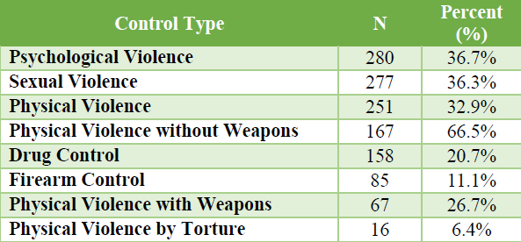
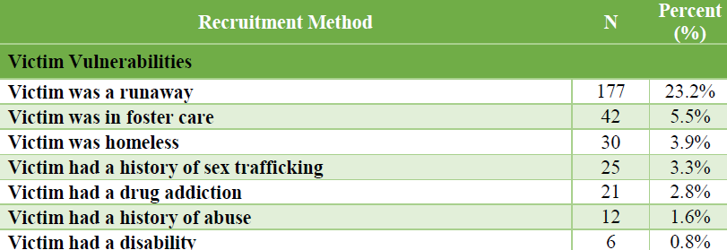

Slide 10
What to watch for…
Missing work or school
New belongings
Change in routine
Hotel keys
Controlling boyfriend or older man
New tattoos
Injuries
Exhaustion
Weight loss
New cell phone or multiple new cell phones
Credit cards

Slide 11
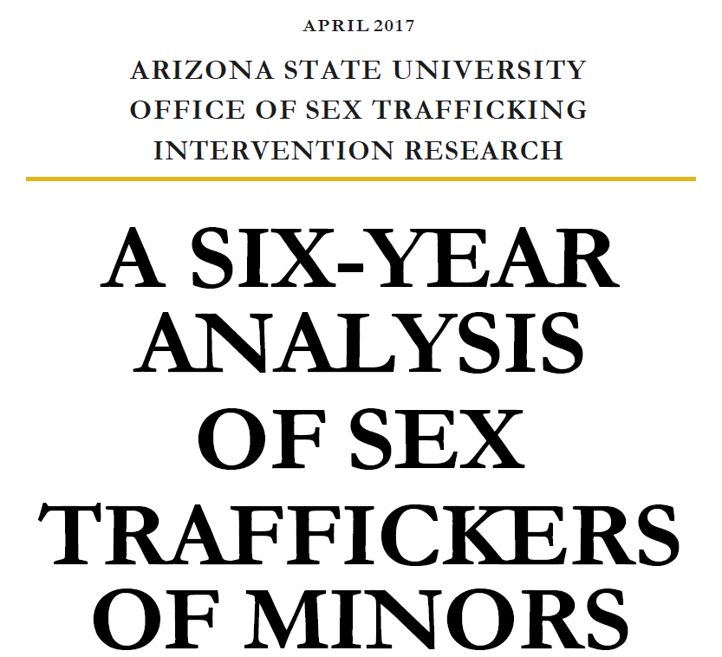
Notes:
Study specific to minors but very typical profile.

Slide 12
Victim age exploitation ranged from 4 – 17; average was 15 years old
More than half were runaways
Minor victims were transported to up to 17 states with the average of 2.7 states
Online ads were used in nearly 2/3rds of the cases
Majority of sex trafficking acts occurred in hotel rooms
Most cases originated with a report to law enforcement, followed by family or anonymous caller
1 out of 5 arrests involved someone affiliated with a gang
Over 55% of the arrests were female; “bottom”

Slide 13
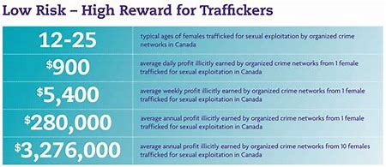
What we can learn
1/3 involved the transportation of a minor across state lines
More than half had some previous relationship with their traffickers; knew their vulnerabilities
Victimization ranged from one day to 11 years; average was 154 days.
Majority of victims lived at home before being trafficked.
Offenders used “selective” violence.
Notes:
Must include the transportation industry, training to state, county and local police, buses, trains, rental cars, transportation corridors, gas stations, convenience stores
Being a runaway is a critical vulnerability laced with desperation.
Indicates that parents and caregivers must be involved in prevention efforts.
Nearly 20% lived in a group home.
Selective violence is used against one victim in the presence of other victims so that the physical effects felt by one become the psychological effects felt by the other victims.

Slide 14
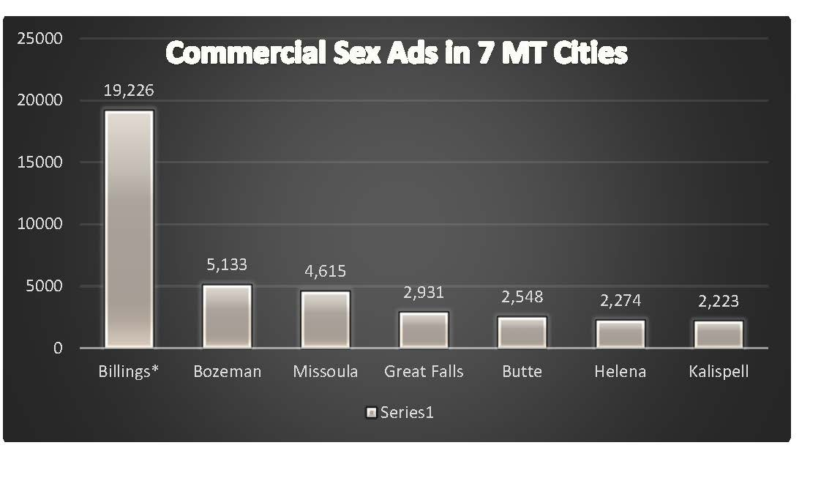

Slide 15
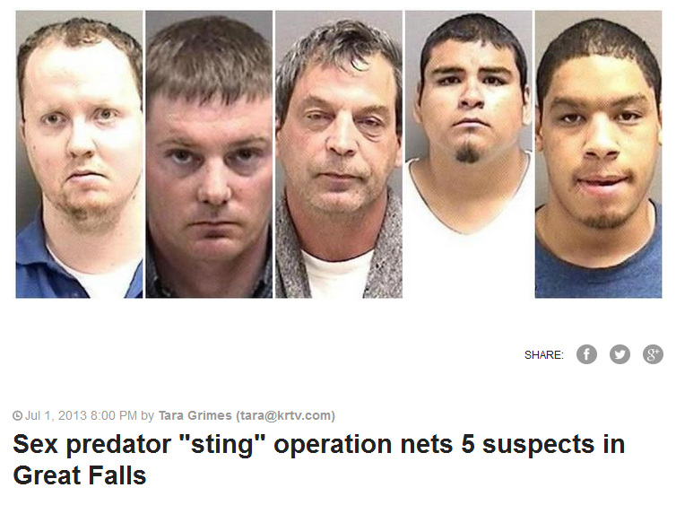
It happens here
GREAT FALLS — Authorities in Great Falls say five men have been taken into custody following an undercover sting operation in which the men sought to have sex with a 12-year-old girl.
Investigators say the local Internet Crimes Against Children task force posted a series of ads on websites beginning June 24.
Police say the men responded to the ads.

Slide 16
Terrance Edwards – 30 Year Sentence
Terrance Edwards was arrested in September 2016 after a woman called for help from a Billings hotel. When police arrived they discovered the woman and several minors were victims of sex trafficking.

Slide 17
How?
…arrived in Billings with three teenage girls he’d just recruited from North Dakota and Minnesota.
During the trial, several of his victims testified that their relationships with Edwards started out as seemingly romantic, but quickly became violent and controlling. They all testified that he made them call him “daddy.” Edwards also placed online ads for their services, forced them to have commercial sex, and required them to turn all the money they made over to him. When asked by the defense attorney why none of the women called the police, one witness said that it would be “pointless.”

Slide 18
What is next?
Where do we go from here?

Slide 19
Dana Toole Dtoole@mt.gov 406-444-1525

