Slide 1
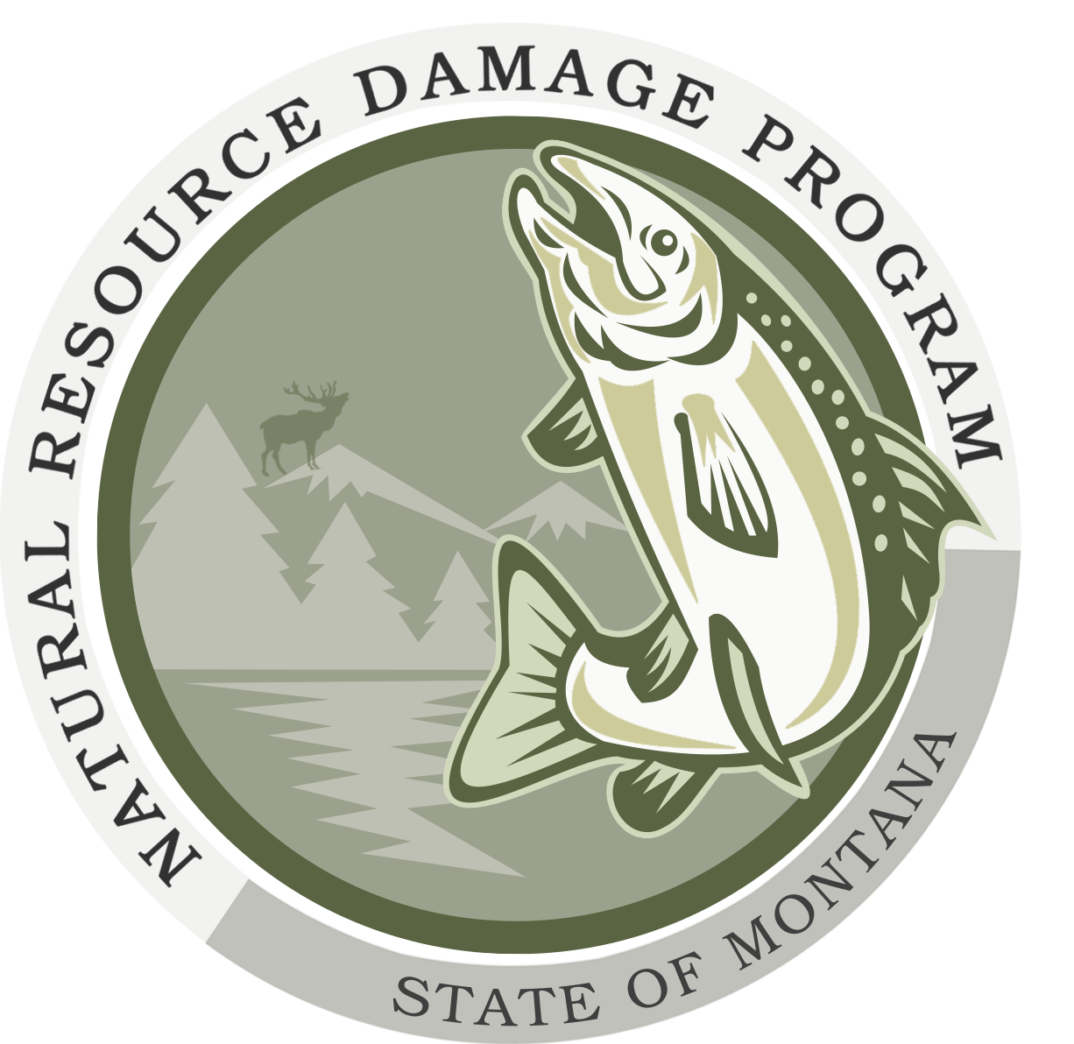
Draft Natural Resource Damage Assessment work Plan Reed Point Bridge Derailment
June 26, 2024
Stillwater County Civic Center
16 Sheep Dip Road
Columbus, MT 59019

Slide 2
Hybrid Meeting Procedures
This meeting is being recorded
All participants, please announce your name before speaking

Slide 3
Agenda
Introduction
Natural Resource Damage Background
Reed Point Bridge Derailment Background
Natural Resource Damage Assessment Work Plan
How You Can Participate
Questions
Who We Are
Montana Natural Resource Damage Program (NRDP)
Doug Martin, Acting Program Administrator
Sydney Stewart, Project Manager
Katherine Hausrath, Chief Legal Counsel
Jamie Holmes, Abt Global

Slide 4
Natural Resource Damage Program
Mission: To recover damages for natural resources injured by the release of hazardous substances and to restore, rehabilitate, replace, or acquire the equivalent of the injured natural resources.
Established in 1990 to pursue natural resource damage claims in MT v ARCO
Work on behalf of the Governor, who is the Trustee for natural resources in the State of Montana
Work under “natural resource damage” provisions in CERCLA (federal Superfund), CECRA (State Superfund), and OPA (Oil Pollution Act)

Slide 5
Natural Resource Damage Law
Work under natural resource damage provisions in state and federal law:
OPA (Oil Pollution Act)
CERCLA (Superfund)
CECRA (State equivalent of Superfund)
Natural Resource Damage (NRD) provisions
Trustees can recover damages for injury to natural resources caused by the release of hazardous substances.
Recovered damages must be used to restore, replace, or acquire the equivalent of the injured resources.
Objective is to return the injured resources to “baseline” conditions. If this is not possible, funds can be used to replace the injured resources.

Slide 6
Definitions
Natural Resources
Land, fish, wildlife, biota, air, water, groundwater, drinking water supplies, and other such resources belonging to, managed by, held in trust by, appertaining to, or otherwise controlled by the United States, any state or local government or Indian tribe, or any foreign government
Injury
An observable or measurable adverse change in a natural resource or impairment of a natural resource service
Damages
Damages for injury to, destruction of, loss of, or loss of use of, natural resources, including the reasonable costs of assessing these damages
A sum of money claimed or awarded in compensation for a loss or an injury

Slide 7
Remediation / Restoration
Release
Baseline
Residual injury and service loss
Interim Losses
Resources
Risk-based cleanup complete
Response Action
No Action
Time

Slide 8
Natural Resource Damage Assessment Phases
Cleanup
Unified Command
Removal of rail cars and asphalt
Phase 1
Phase 2
Preassessment Phase
Restoration Planning Phase
Restoration Implementation Phase
Spill
NRDA
NRDP, working on behalf of the Governor (Trustee for State resources)
How were natural resources impacted and what will it take to return them to the state they would have been in if the spill had never occurred
Notes:
I’m Sydney Stewart with NRDP – I’ll get into the specifics of Reed Point. This shows the general natural resource damage assessment (NRDA) process under the Oil Pollution Act. First there’s a spill and probably what most of you are familiar with so far is the cleanup, which is usually overseen by EPA and DEQ. The NRDA process is separate from the cleanup, but there is some overlap. There are three main phases – the preassessment, restoration planning, and restoration implementation phases. So I’ll run through each of these but first I want to talk about the spill itself – I’m sure people here are pretty familiar with it, but just to set the stage for the presentation…

Slide 9
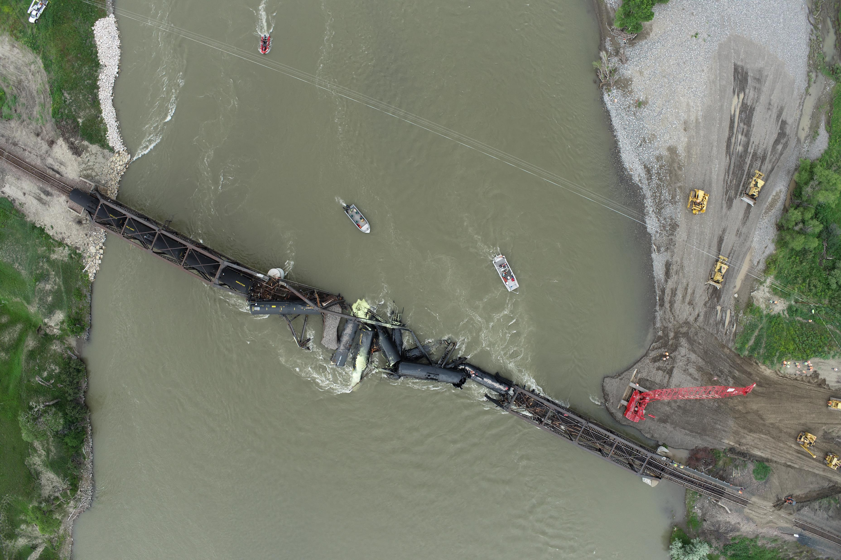
Reed Point Bridge Derailment (A/K/A Stillwater Train derailment)
Photo from Arcadis, June 26, 2023
June 24, 2023, derailment released asphalt (~ 420,000 lbs), sulfur, and scrap metal into the river
MRL is the responsible party
Asphalt is an oil product, so MRL is liable for natural resource damages for injuries to natural resources or services caused by the asphalt and response actions, pursuant to the Oil Pollution Act (OPA)
Notes:
June 24, 2023 a train derailed into the Yellowstone River. Train cars carrying liquified petroleum asphalt, sulfur, and scrap metal released contents into the Yellowstone River. Montana Rail Link (MRL) is the responsible party for the incident and because asphalt is an oil product they are liable for natural resource damages under the Oil Pollution Act or OPA. They’re liable for injuries to natural resources caused by the release of the asphalt and associated response/cleanup actions.

Slide 10
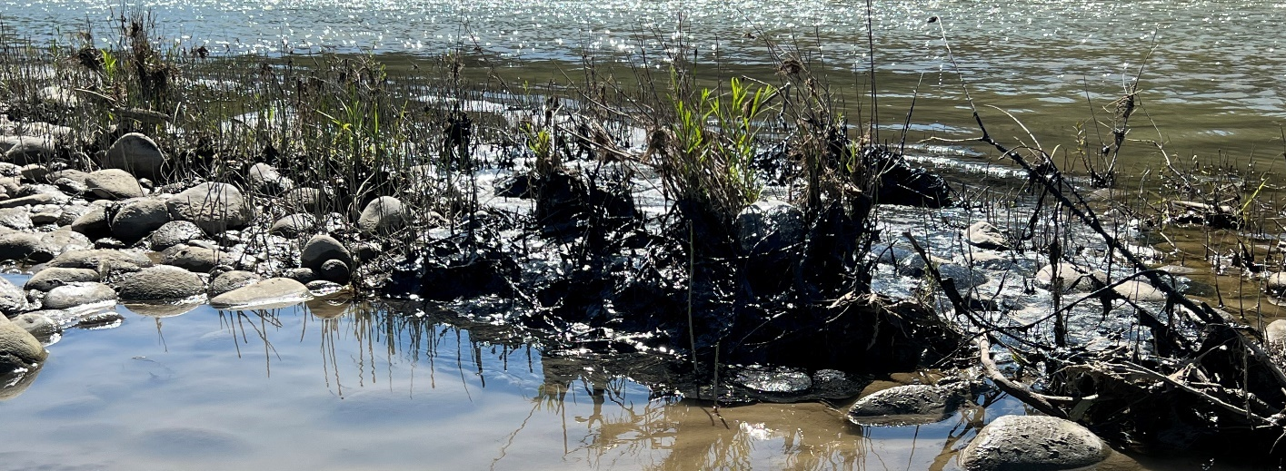
Overview
Asphalt found in the Yellowstone River over130 miles downstream
Impacted many habitat types
Approximately 60% of asphalt removed to date (180,000 lbs remaining)
Photo from Whitewater Rescue Institute
Photo from Abt Associates
Notes:
Asphalt was found in the Yellowstone River over 130 miles downstream of the spill site and impacted many different habitat types – you can see in the photos here asphalt on rocky shorelines, in the river, and on vegetation. Approximately 60% of the asphalt was removed during the cleanup operations, meaning approximately 180,000 pounds still remain in the environment.

Slide 11
Natural Resource Damage Assessment Phases
Cleanup
Preassessment Phase
Restoration Planning Phase
Restoration Implementation Phase
Spill
Notes:
The first step in the NRDA process is the preassessment phase. We’ve completed this phase and I’ll just walk through it briefly

Slide 12
Preassessment Phase
Preassessment conditions
Determination of jurisdiction
Injuries have resulted, or are likely to result, from the incident
Response actions have not adequately addressed, or are not expected to address, those injuries
Feasible restoration actions exist to address the potential injuries
If the conditions are met, trustees may proceed and issue a Notice of Intent to Conduct Restoration Planning (NOI)
Reed Point
Invited MRL to participate in the natural resource damage assessment (NRDA)
NRDP issued a NOI to Montana Rail Link (November 20, 2023)
MRL accepted the invitation
Notes:
In this phase, we’re looking to see if certain conditions, specified in the OPA regs, are met. Determination of jurisdiction – are there natural resources under the State’s trusteeship that have been affected. Have those natural resources been injured or are they likely to have been injured by the incident. Response actions will not adequately address the injuries – this isn’t to say that response isn’t doing it’s job. The cleanup is aimed at reducing risk to human health and the environment, while restoration is aimed at restoring the natural resources to state they would have been in if the spill had never happened, and compensating the public for any lost use of those resources. So the Unified Command can be doing it’s job as required under OPA and there can still be injuries to natural resources that are not addressed. Finally, we have to look at whether there are feasible restoration actions that exist to address the injuries. If all these conditions are met, the trustee can issue a Notice of Intent to Conduct Restoration Planning and proceed with the NRDA process. At Reed Point, we issued a Notice of Intent to MRL in November. As part of this we invited MRL to participate in the NRDA. We did this because it’s outlined in the regulations and because we see benefits to conducting a participatory NRDA. MRL accepted the invitation – they reimbursed the State for some of the preassessment costs and they are funding development of this NRDA Work Plan. This means MRL is footing the bill for this work rather than the State of Montana. It also means we share data with MRL and MRL shares data with us, and that we work together when we identify data that needs to be collected, avoiding any duplication of efforts. Ultimately, though, it is very clear in our agreement that this is the State’s Work Plan and all final decisions are to be made by the State.

Slide 13
Natural Resource Damage Assessment Phases
Cleanup
Preassessment Phase
Restoration Planning Phase
Restoration Implementation Phase
Spill
Notes:
Now we’re in the Restoration Planning Phase, where we actually do the assessment of injuries and calculation of damages.

Slide 14
Restoration Planning Process
NRDA Work Plan
Reduction of Recreational Services
Ecological Injuries
Injury assessment
Injury determination
Injury quantification
Restoration selection
Develop restoration alternatives
Evaluate alternatives
Develop restoration plans
Notes:
There are two main parts to this phase – the Injury Assessment and the Restoration Selection. The NRDA Work Plan out for public comment covers the Injury Assessment Phase, both injury determination and injury quantification. Looking at the details of this site, we’re focusing on two types of injuries – Reduction in recreational services and ecological injuries.

Slide 15
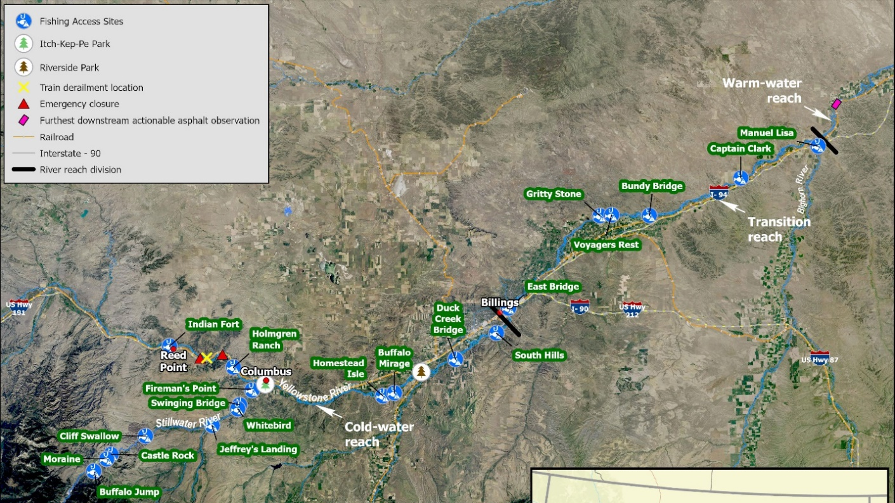
Assessment Area
Spill site
River Closure
Furthest downstream actionable asphalt observed
River Closure
Stillwater River
Notes:
The area we’re looking at is called the Assessment Area – I know there’s a lot on this map, but briefly we’re looking at the site where the derailment occurred, upstream areas that were impacted by the river closure, and downstream areas affected by the closure and the asphalt. So the yellow X is the derailment site, the red triangles show the extents of the river closure, and the purple/pink rectangle shows how far downstream they observed actionable asphalt during the cleanup. We’re also looking at tributaries to the Yellowstone – namely the Stillwater River, which had some initial emergency closures immediately after the spill and recreational use of the lower section may have been impacted by the operations in Columbus.

Slide 16
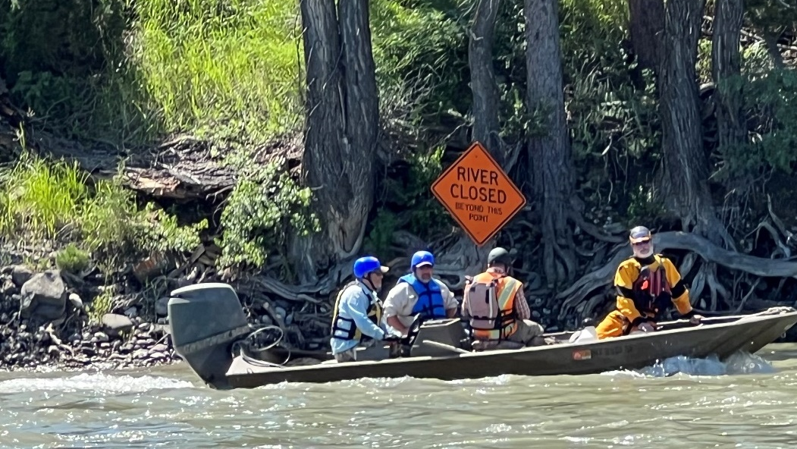
Recreation Impacts
Initial emergency closures on the Yellowstone and Stillwater Rivers
3.5 miles of the Yellowstone River closed June 27 to July 29, 2024
Holmgren Ranch closure June 30 to July 21
Itch-Kep-Pe ramp closure July 8 to July 21
Additional staging areas
Photo from Abt Associates
Notes:
As far as impacts to recreational services caused by the spill and response actions, there were initial emergency closures on the Yellowstone and Stillwater Rivers. Then about 3.5 miles of the Yellowstone was officially closed for about a month while the cleanup was going on. Holmgren Ranch FAS was closed for about 3 weeks while it was heavily used for cleanup operations, and the Itch-Kep-Pe boat ramp was closed for about 2 weeks for the cleanup operations. In addition to official closures, there were boats going up and down the river and other FASs used for staging areas, which may have impacted people’s use and enjoyment of the river.

Slide 17
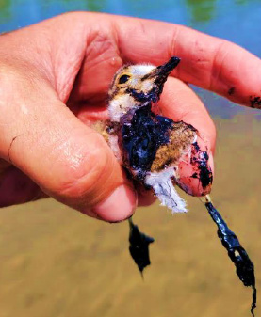
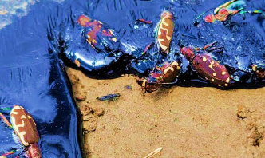
Wildlife Mortality and Impacts
Bird, snake, and invertebrate fatalities
Asphalt remaining in aquatic and shoreline habitat
Alterations to the shoreline during cleanup
Fish
FWP fish sampling showed abrasions/lesions and petroleum-related contaminants in fish tissue
Fish Consumption Advisory
Link to incident unclear
Photos: Ostovar, K. 2023. Assessment of Spiny Softshell Turtle (Apalone spinifera) Nest Sites – Potential Effects of an Asphalt Spill Related to the Reed Point Train Derailment. Final Report.
Notes:
On the ecological side, we saw bird, snake, and invertebrate fatalities resulting from the spill – in the photos here you can see an oiled bird, a spider stuck in the asphalt, and some beetles stuck in the asphalt. There’s also asphalt in different habitats along the river and we know there’s quite a bit still out there. And as part of the cleanup there were alterations to the shoreline, for example when they built a causeway to get out to the train or excavated a channel at Buffalo Mirage. Again, we look at the impacts from the asphalt itself but also from the cleanup operations.
For the fish, FWP did some fish sampling immediately following the spill and found abrasions and lesions on the fish around the spill site as well as petroleum-related contaminants (PAHs) in the fish tissue. This led FWP to issue a fish consumption advisory. The sampling was done because the train derailed, but we have not been able to draw a clear link between the derailment and the contamination in the fish. Some folks from FWP are here if you have questions about the fish consumption advisory, but for the purpose of the NRDA Work Plan, any contamination in the fish would feed into our ecological injury, as well as recreational injury if it led to a fish consumption advisory. However, we have to be able to show the pathway from the derailment to the fish and we’re not sure if that’s the case. So, we have this in the work plan and we will look into it, but we’re not sure if it will end up being part of the final claim.

Slide 18
Remediation / Restoration
Release
Baseline
Residual injury and service loss
Interim Losses
Resources
Risk-based cleanup complete
Response Action
No Action
Time
Notes:
So next I’m going to talk about how we assess injury, but I wanted to throw this graph up again to help explain the goal of what we’re doing. Doug explained this already, but we’re looking at the total injuries – so that’s adverse impacts to natural resource or reduction in the services they provide – and we’re looking at spatial extent of the injuries as well as the amount of time the resources were injured. Again, that whole shaded area is the injury. So we’re looking at identifying what the injuries are and then quantifying them, and then we can look at how to make the public whole for those injuries.

Slide 19
Approach to injury assessment Injury Identification
Recreational Services
■ Degree to which injuries to public services occurred as a result of the incident and response
■ Example activities: fishing, boating, rafting, kayaking, floating, swimming, etc.
■ FWP fishing pressure data (2013-2021 compared to 2023)
Ecological Resources
■ Footprint of habitat physically covered by asphalt
■ Impacts to habitat from heavy equipment use, staging grounds, channel excavation
■ Riprap placed above the derailment
■ Existing surface water, sediment, soil, and fish tissue samples, compare to adverse effect levels
Notes:
So again, first is the injury identification – this looks a little different for recreational and ecological resources. On the recreation side, we’re looking at the degree to which injuries to public services occurred as a result of the incident and response actions. We’re looking at fishing, boating, rafting, swimming, rockhounding – all the different ways people use the river recreationally. And we’re going to look at the reduction in use of the river using data collected by FWP. Every other year FWP does surveys in Montana to look at fishing pressure on different rivers. We have the survey data from 2013 to 2021, and lucky for us 2023 was also a survey year. So we can look at the fishing pressure data for 2023 and compare that to the historic data to get an idea of whether there was a reduction in use due to the spill and cleanup operations.
On the ecological side, we’re proposing to look at the injury to the entire habitat. From the asphalt, we’ll look at the area of habitat physically covered, or smothered, by the asphalt. We’ll also look at impacts to habitat from the response operations – so heavy equipment use, staging grounds, and channel excavation. There was also riprap placed above the derailment using materials from the response actions – we’re not sure if this is something that can be included in a claim, but we don’t know enough about it yet so we’re going to look into it as part of the assessment. And then we’ll look at sample data from different site media, like surface water and sediment, to see if there’s contamination at levels that could cause adverse effects to natural resources.

Slide 20
Approach to injury assessment Injury Quantification
Recreational Services
■ “Benefits transfer” approach
■ Assign dollar value to recreational activities (e.g., $/day of recreational fishing)
■ Use established values from literature
■ Estimate lost days, convert to $ value
Ecological Resources
■ Habitat Equivalency Analysis (HEA)
■ Area of habitat degraded by the asphalt
■ Determine debits as discounted service acre-years (DSAYs)
■ Use quantifiable metrics to determine habitat service loss from injuries
Notes:
So that’s how we’ll look at the injury, then we have to quantify the injury. For recreational services, we’ll use a benefits transfer approach. To do this, we can assign a dollar value to each type of recreational use of the river – so we’ll say people value a day of recreational fishing at $X per day. And we won’t just make up numbers, there are values established in the literature for this that have been developed by economists. Then we can look at the lost user days estimated from the fishing pressure data and multiply that by the $/day for each activity and come up with an overall dollar amount to represent the recreational losses.
On the ecological side, we’ll use a technique called the Habitat Equivalency Analysis, or HEA. This looks at the services provided by habitat and focuses on quantifiable metrics so we can look at a reduction in services provided by the habitat. The area will be defined by the area of habitat covered by asphalt, which we consider degraded habitat. So we’ll look at the reduction in services from that degraded area over time, and that’s expressed in discounted service acre years, or DSAYs. So basically the reduction in services, per acre, per year. Overall we’ll look at the injuries as debits, and then we’ll look at restoration as credits and we’ll try to balance debits and credits. This is a complicated process, we have our expert online if people want to get into it, but that’s the general process we’re proposing for looking at ecological injuries – covering the entire habitat and services provided to wildlife, in both a spatial context and a temporal context.

Slide 21
Restoration Planning Process
NRDA Work Plan
Injury assessment
Injury determination
Injury quantification
Restoration selection
Develop restoration alternatives
Evaluate alternatives
Develop restoration plans
Notes:
That’s what’s covered in the Work Plan that we have out right now – it’s our plan for assessing the injury. The next step in the NRDA process is restoration selection, it’s not covered in the work plan but I want to talk about it briefly because I think it might help give some context for why we’re doing things this way.

Slide 22
Next Steps Restoration Selection
Recreational Services
■ Estimated lost days and converted to $ value
■ Determine appropriate restoration actions to compensate for this loss
Ecological Resources
■ Determined debits as DSAYs
■ Can be converted to a cost of restoration per unit credit
■ Determine credits (habitat service gain) as DSAYs that can be obtained through restoration
Notes:
On the recreational side, we’ll estimate the lost days and convert that to a dollar amount, then we’ll determine appropriate restoration actions to compensate people for those losses. This could look like constructing a new fishing access site that improves access to the Yellowstone River, or something like that.
On the ecological side, we’ll determine that debit as discounted service acre years, and then we’ll determine the credits – so that’s looking at improving habitat through restoration actions. So the goal is to look at the debits on the injury side and balance that with credits on the restoration side. Then we can convert the credits to a dollar amount as well using the cost of restoration per DSAY. So again, this is complicated, and this portion isn’t covered in the work plan, but hopefully it gives you an idea of we can convert injuries to natural resources into monetary damages.

Slide 23
How You Can Participate
Submit a comment
Reports of asphalt
Feedback on the NRDA Work Plan
Information on ecological or recreational impacts from the derailment or response actions (past and on-going)
Submit observations of asphalt remaining in the environment to rpderailment@mtrail.com
Report any impacted wildlife to FWP and Oiled Wildlife Care Network Response Hotline (888-275-6926)
Notes:
So that’s what’s in the Work Plan, plus a little bit. We’re here to solicit feedback on the work plan, so if you have any thoughts on the assessment approach that we’re taking, please send it in. Also, if you have any additional information about how the natural resources or services were impacted by the spill, we’d be interested in hearing that as well. So any impacts to habitat or wildlife, or how the asphalt spill impacted recreational use of the river. If you’re out on the river and see asphalt, I also just want to put out a reminder that you can (and should) report that to the MRL – the email is rpderailment@mtrail.com. MRL shares these reports with us, so we’ll also get that information. And if you see any impacted wildlife, please share that with FWP (who will share it with us) and the Oiled Wildlife Care Network Response Hotline.

Slide 24
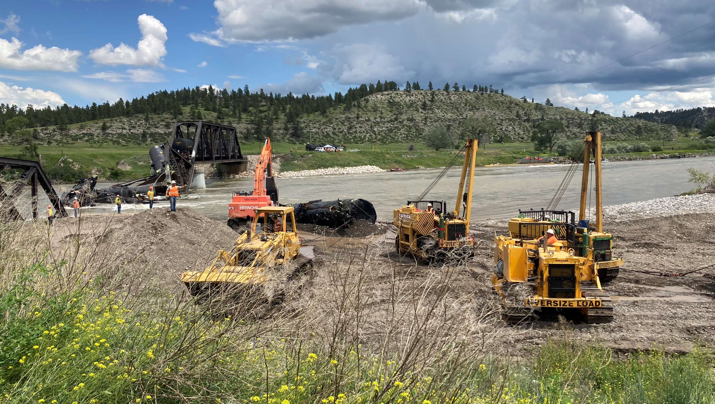
How to Submit
Sydney Stewart
sydney.stewart@mt.gov
(406) 444-1346
Doug Martin
dougmartin@mt.gov
(406) 444-0234
NRDA Work Plan
https://dojmt.gov/lands/nrdp-public-notices/notices-of-public-comment/
Submit comments by 11:59 PM on July 12, 2024
Email nrdp@mt.gov
Subject: “Reed Point Draft NRDA Work Plan”
Natural Resource Damage Program
1720 9th Ave
PO Box 201425
Helena, MT 59601-1425
Notes:
For comments on the work plan, please send them to us by July 12. You can email them to nrdp@mt.gov. Please use the subject line Reed Point Draft NRDA Work Plan – we have a couple comment periods going right now so that helps us keep the comments organized. You can mail them to us if you’d prefer. This is the link to where you can find the work plan, and mine and Doug’s contact information. I’ll leave this slide up and we have it printed off if you want to take a copy with you. And with that we can take questions. Thank you!

Slide 25
National Pollution Funds Center (NPFC)
Oil Spill Liability Trust Fund and NPFC established by OPA
Funded by oil tax
Can submit different types of claims, including:
Cleanup
NRD assessment and restoration
Property damage
Loss of profits & earning capacity
https://www.uscg.mil/Mariners/National-Pollution-Funds-Center/Claims/

Slide 26
How To Submit
Sydney Stewart
sydney.stewart@mt.gov
(406) 444-1346
Doug Martin
dougmartin@mt.gov
(406) 444-0234
NRDA Work Plan
https://dojmt.gov/lands/nrdp-public-notices/notices-of-public-comment/
Submit comments by11:59 PM on July 12, 2024
Email nrdp@mt.gov
Subject: “Reed Point Draft NRDA Work Plan”
Natural Resource Damage Program
1720 9th Ave
PO Box 201425
Helena, MT 59620-1425

